Slide 1
Practical Java for IT Professionals
Kristof Werling KwerlingIT GmbH 1 Sept 2023

Slide 2




Who am I
Kristof Werling
31 years of experience at HP: DevOp, Developer, Architect
Started KwerlingIT GmbH
Focus: IT / Cyber Security
Security Audits, IT consulting, Trainings, Software creation
KwerlingIT GmbH
kristof.werling@kwerlingit.com
https://www.linkedin.com/in/kristof-werling/
https://www.kwerlingit.com

Slide 3
Table of Content
Git Training (separate set of slides)
Familiarization with Java
Networking (Sockets, REST Webservices, Message Bus)
Databases (Relational DBs, SQL, KV-DB)
Web UIs (Bootstrap)

Slide 4
Module A introduction/warming up
Just writing some Java code and getting to know some of the oddities.

Slide 5
Content
Command line parameters
Working with Strings
Garbage Collector
Command Line Parameters
Reverse Polish Calculator
Unit testing

Slide 6
Command line parameters
IntelliJ provides one with a default Java program
The "args" array contains the command line parameters
public class Main { public static void main(String[] args) { System.out.println("Hello world!"); } }

Slide 7

Exercise A010
Write a program, which prints out the command line parameters in reverse order
Make sure that the source code is in the name space "de.porsche"

Slide 8
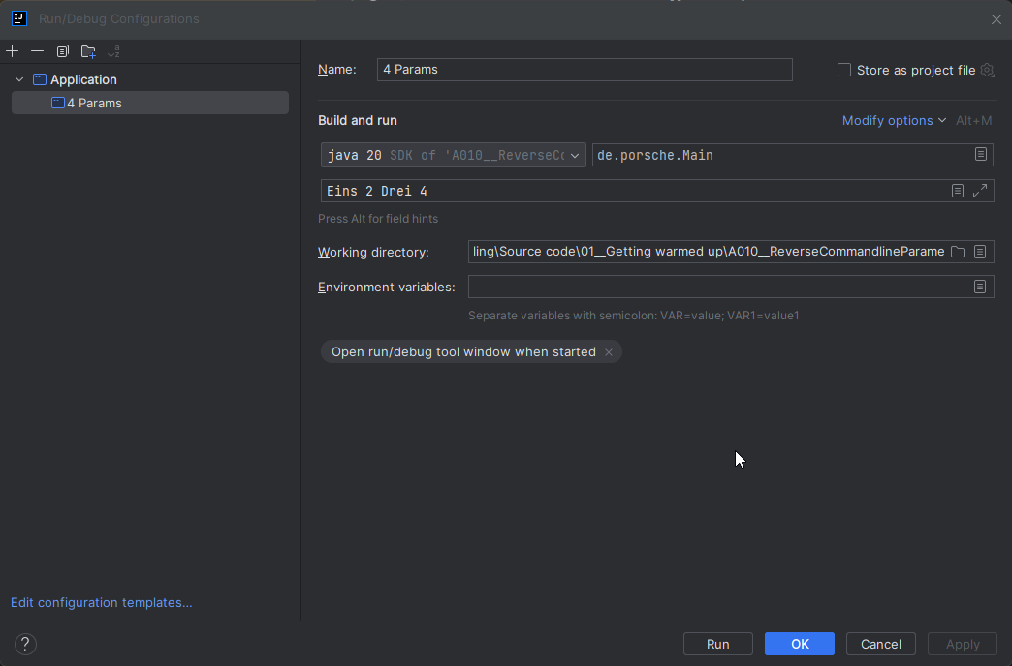
Setting Run configuration

Slide 9
Solution A010
package de.porsche; public class Main { public static void main(String[] args) { for(int i = args.length - 1; i >= 0; i--) { System.out.println("Parameter #" + i + "\t" + args[i]); } } }

Slide 10
Working with Strings
(some) String class method | Functionality
String toLowerCase() | Returns all lowercase string.
String toUpperCase() | Returns all UPPERCASE string.
String trim() | Removes beginning and ending spaces of this string.
int indexOf(String substring) | Returns the start position of a substring in a string.
String[] split(String regex) | Splits string at matching regex. Returns an array.
boolean contains(CharSequence s) | Returns of character sequence is contained in string.
int length() | It returns the string length. Compare to Array.length !!
String substring(int beginIndex, int endIndex) | Returns a substring.

Slide 11
Working with Strings
RegEx character | What is it? | What does it match
[abcA-Z0-3] | Character class | Any character in the brackets. 0-3 stands for 0, 1, 2, 3 (range)
. | Metacharacter | Any character but linefeed
* ? + {2} {2,} {2,4} | Quantifiers | How often: zero or more, zero or one, one or more, exactly 2 times, at least 2 times, 2, 3 or 4 times
\t \r \n | White space | Tab, carriage return, linefeed
^ $ | Anchors | Beginning and End of line
There is much more to know about RegEx. Please do your own research online.

Slide 12
Working with Strings
RegEx
H[ao]use? | Matches : Haus, House, aber auch Hause
Han{2}a | Matches: Hanna
Gr[ae]y | Matches: Grey or Gray
Cat$ | Line ends with the word Cat
^Here we go | Line starts with: Here we go
^[\t ]*Here we go | Line starts with or without whitespaces followed by the text: Here we go
There is much more to know about RegEx. Please do your own research online.

Slide 13
Working with Strings
Part 1
package de.porsche; public class Main { public static void main(String[] args) { System.out.println("Explain the following results:" ); // Bad : Variables are to be declared on top of the block System.out.println( "" ); System.out.println( "" ); String S1 = "Hello World"; String S2 = S1; System.out.println( " S1 and S2 are equal : " + ( S1 == S2 ) ); System.out.println( " S1 and S2 have the same content: " + ( S1.compareTo(S2) == 0 ) ); System.out.println( "" ); System.out.println( "" ); String S3 = "Hello World"; System.out.println( " S1 and S3 are equal : " + ( S1 == S3 ) ); System.out.println( " S2 and S3 are equal : " + ( S2 == S3 ) ); System.out.println( " S1 and S3 have the same content: " + ( S1.compareTo(S3) == 0 ) ); System.out.println( " S2 and S3 have the same content: " + ( S2.compareTo(S3) == 0 ) );

Slide 14
Working with Strings
Part 2
System.out.println( "" ); System.out.println( "" ); String S4 = new String("Hello World"); System.out.println( " S1 and S4 are equal : " + ( S1 == S4 ) ); System.out.println( " S1 and S4 have the same content: " + ( S1.compareTo(S4) == 0 ) ); System.out.println( "" ); System.out.println( "" ); String S5 = "Hello " + "World"; System.out.println( " S1 and S5 are equal : " + ( S1 == S5 ) ); System.out.println( " S1 and S5 have the same content: " + ( S1.compareTo(S5) == 0 ) ); System.out.println( "" ); System.out.println( "" ); String S6 = "Hello "; S6 = S6 + "World"; System.out.println( " S1 and S6 are equal : " + ( S1 == S6 ) ); System.out.println( " S1 and S6 have the same content: " + ( S1.compareTo(S6) == 0 ) );

Slide 15
Working with Strings
Part 3
System.out.println( "" ); System.out.println( "" ); System.out.println( " S1 identity hash code : " + System.identityHashCode(S1)); System.out.println( " S2 identity hash code : " + System.identityHashCode(S2)); System.out.println( " S3 identity hash code : " + System.identityHashCode(S3)); System.out.println( " S4 identity hash code : " + System.identityHashCode(S4)); System.out.println( " S5 identity hash code : " + System.identityHashCode(S5)); System.out.println( " S6 identity hash code : " + System.identityHashCode(S6)); System.out.println( "" ); System.out.println( "" ); S5 = "Another text"; System.out.println( " S5 identity hash code : " + System.identityHashCode(S5)); } }

Slide 16
Exercise A020
Run the program in the 3 slides before and explain the result

Slide 17
Working with Strings
Part 1
package de.porsche; public class Main { static long startTime = 0; static long endTime = 0; static void startTimer() { startTime = System.nanoTime(); } static void endTimer() { endTime = System.nanoTime(); } static void timerResults() { long duration = endTime - startTime; System.out.println("The operation took \n" + duration + " nano seconds\n" + duration / 1000 + " micro seconds\n" + duration / 1000000 + " milli seconds\n" + duration / 1000000000 + " seconds\n"); }

Slide 18
Working with Strings
Part 2
public static void main(String[] args) { String sourceString = "1234".repeat(256); System.out.println("Source string length: " + sourceString.length()); String resultString = ""; // To get some idea of how long a loop takes System.out.println("Empty For-Loop, 100 iterations"); startTimer(); for (int i = 0; i < 100; i++) { } endTimer(); timerResults(); System.out.println("\n\n"); System.out.println("Empty For-Loop, 1 million iterations"); startTimer(); for (int i = 0; i < 1000000; i++) { } endTimer(); timerResults(); System.out.println("\n\n");

Slide 19
Working with Strings
Part 3
System.out.println("Concat string, 100 iterations"); resultString = ""; startTimer(); for (int i = 0; i < 100; i++) { resultString = resultString + sourceString; } endTimer(); System.out.println("Result string length: " + resultString.length()); timerResults(); System.out.println("\n\n"); System.out.println("Concat string, 1000 iterations"); resultString = ""; startTimer(); for (int i = 0; i < 1000; i++) { resultString = resultString + sourceString; } endTimer(); System.out.println("Result string length: " + resultString.length()); timerResults(); System.out.println("\n\n");

Slide 20
Working with Strings
Part 4
System.out.println("Concat string, 10000 iterations"); resultString = ""; startTimer(); for (int i = 0; i < 10000; i++) { resultString = resultString + sourceString; } endTimer(); System.out.println("Result string length: " + resultString.length()); timerResults(); System.out.println("\n\n"); // System.out.println("Concat string, 100000 iterations"); // resultString = ""; // startTimer(); // for (int i = 0; i < 100000; i++) { // // resultString = resultString + sourceString; // // Took 1010 secs on my machine. // } // endTimer(); // System.out.println("Result string length: " + resultString.length()); // timerResults(); // System.out.println("\n\n");

Slide 21
Working with Strings
Part 5
System.out.println("Concat string -- Stringbuffer , 100000 iterations"); resultString = ""; StringBuffer sbuf = new StringBuffer(); startTimer(); for (int i = 0; i < 100000; i++) { sbuf.append(sourceString); } endTimer(); resultString = sbuf.toString(); System.out.println("Result string length: " + resultString.length()); timerResults(); System.out.println("\n\n");

Slide 22
Working with Strings
Part 6
System.out.println("Concat string -- Stringbuffer 32, 100000 iterations"); resultString = ""; sbuf = new StringBuffer(32); startTimer(); for (int i = 0; i < 100000; i++) { sbuf.append(sourceString); } endTimer(); resultString = sbuf.toString(); System.out.println("Result string length: " + resultString.length()); timerResults(); System.out.println("\n\n");

Slide 23
Working with Strings
Part 7
System.out.println("Concat string -- Stringbuilder , 100000 iterations"); resultString = ""; StringBuilder sbuild = new StringBuilder(); startTimer(); for (int i = 0; i < 100000; i++) { sbuild.append(sourceString); } endTimer(); resultString = sbuild.toString(); System.out.println("Result string length: " + resultString.length()); timerResults(); System.out.println("\n\n"); } }

Slide 24
Exercise A030
Run the program in the 7 slides before and explain the result

Slide 25
Garbage Collector
Part 1
package de.porsche; import java.util.Date; class Main { private Thread thread; private boolean running; public Main() { running = true; thread = new Thread(() -> { while (running) { System.out.println(getTime() + "\t" + "Hello from the Class"); Main.waitForSecs(10); } }); thread.start(); }

Slide 26
Garbage Collector
Part 2
@Override protected void finalize() throws Throwable { running = false; thread.interrupt(); thread.join(); System.out.println("Class is finished"); } String getTime() { String retVal = ""; Date date = new Date(); long timeInMillis = date.getTime(); // Calculate the hours, minutes, and milliseconds int hours = (int) date.getHours(); int minutes = (int) ((timeInMillis / (1000 * 60)) % 60); int seconds = (int) ((timeInMillis / 1000) % 60); int milliseconds = (int) (timeInMillis % 1000); retVal = String.format("%02d", hours) + ":" + String.format("%02d", minutes) + ":" + String.format("%02d", seconds) + "." + String.format("%03d", milliseconds); return retVal; }

Slide 27
Garbage Collector
Part 3
static void waitForSecs( int secs) { try { Thread.sleep(secs * 1000); } catch (InterruptedException e) { e.printStackTrace(); } } public static void main(String[] args) { Main instance = new Main(); System.out.println("After instantiation -> Start waiting for 30 seconds."); Main.waitForSecs(30); System.out.println("Wait is over."); instance = null; // Collect the object for garbage collection System.out.println("After setting reference variable to null -> Start waiting for 30 seconds."); Main.waitForSecs(30); System.out.println("Wait is over."); System.gc(); System.out.println("After calling Garbage Collector explicitely -> Start waiting for 30 seconds."); Main.waitForSecs(30); System.out.println("Wait is over."); } }

Slide 28
Exercise A040
Run the program in the 3 slides before and explain the result

Slide 29
Command Line Parameters 2
Part 1
The static method Integer.parse(<String>) returns the integer value of the String, or, if String is no integer, throws an exception
Examples:
String paramter for Integer.parse | Result
"34" | Integer value: 34
"3987" | Integer value: 3987
"Vier" | Throws an exception

Slide 30
Exercise A050
Write a program, which prints out the command line parameters in reverse order
If the parameter is a valid integer, then add 10 to it before printing it out

Slide 31
Command Line Parameters 2
Part 1
package de.porsche; public class Main { public static void main(String[] args) { boolean isInteger = false; int intVal = -1; for( int i = args.length; i>0; i--) { try { intVal = Integer.parseInt( args[i - 1]) + 10; isInteger = true; } catch( Exception ex ) { isInteger = false; } if( isInteger ) { System.out.println("Param #" + i +": " + intVal + " INTEGER"); } else { System.out.println("Param #" + i + ": " + args[i - 1]); } } } }

Slide 32
Reverse polish notation (UPN)
Example : 3 + 4 * 5 = 23 In RPN it looks like this: 3 4 5 * + RPN calculations work with a stack, which growth upwards. The rules for processing expressions are these: 1. If parameter is a number push it onto the stack into the top position 2. If parameter is an operator, pull the required number from the stack, do the calculation and push the result back onto the stack.

Slide 33
Reverse polish notation (UPN)
Example : 3 4 5 * +
Push 3
Push 4
Push 5
Pull 5 and Pull 4, multiply them and push 20 back on the stack
Pull 20 and Pull 3, add them, and push 23 onto the stack
5
4
3
20
3
23

Slide 34
Exercise A060
Write a reverse polish notation calculator.
Take the input from the command line parameters
Assume that the input syntax is correct – no error checking is done
The last step of the program is to print out the top of the stack (result)

Slide 35
Reverse polish notation (UPN)
Part 1
package de.porsche; public class Main { public static void main(String[] args) throws Exception { String expression = "1 2 + 3 *"; RpnCalculator calculator = new RpnCalculator(); int result = calculator.evaluate(expression); System.out.println(result); // } }

Slide 36
Reverse polish notation (UPN)
Part 2
package de.porsche; import java.util.Stack; interface Operator { int apply(int operand1, int operand2); } public class RpnCalculator { private final Stack<Integer> stack; public RpnCalculator() { stack = new Stack<>(); }

Slide 37
Reverse polish notation (UPN)
Part 3
public int evaluate(String expression) throws Exception { String[] tokens = expression.split("\\s+"); for (String token : tokens) { if (isOperator(token)) { Operator operator = getOperator(token); int operand2 = stack.pop(); int operand1 = stack.pop(); int result = operator.apply(operand1, operand2); stack.push(result); } else { int number = Integer.parseInt(token); stack.push(number); } } if (stack.size() != 1) { throw new Exception("Invalid RPN expression"); } return stack.pop(); }

Slide 38
Reverse polish notation (UPN)
Part 4
private boolean isOperator(String token) { return token.equals("+") || token.equals("-") || token.equals("*") || token.equals("/"); } private Operator getOperator(String token) throws Exception { return switch (token) { case "+" -> new AdditionOperator(); case "-" -> new SubtractionOperator(); case "*" -> new MultiplicationOperator(); case "/" -> new DivisionOperator(); default -> throw new Exception("Invalid operator: " + token); }; /* switch (token) { case "+": return new AdditionOperator(); case "-": return new SubtractionOperator(); case "*": return new MultiplicationOperator(); case "/": return new DivisionOperator(); default: throw new Exception("Invalid operator: " + token); } */ }

Slide 39
Reverse polish notation (UPN)
Part 5
class AdditionOperator implements Operator { @Override public int apply(int operand1, int operand2) { return operand1 + operand2; } } class SubtractionOperator implements Operator { @Override public int apply(int operand1, int operand2) { return operand1 - operand2; } }

Slide 40
Reverse polish notation (UPN)
Part 6
class MultiplicationOperator implements Operator { @Override public int apply(int operand1, int operand2) { return operand1 * operand2; } } class DivisionOperator implements Operator { @Override public int apply(int operand1, int operand2) { return operand1 / operand2; } }

Slide 41
Reverse polish notation (UPN)
Discuss the provided solution

Slide 42
Reverse polish notation (UPN)
Part 1
package de.porsche; import java.util.Stack; public class RPNCalculator { public static void main(String[] args) { // Create a stack to store the operands Stack<Integer> stack = new Stack<>(); processCommandLineParams(args, stack); // The result of the calculation is now on the top of the stack int result = stack.pop(); // Print the result to the console System.out.println("The result is: " + result); }

Slide 43
Reverse polish notation (UPN)
Part 2
private static void processCommandLineParams(String[] args, Stack<Integer> stack) { // Iterate over the command line parameters for (String arg : args) { // If the argument is an operand, push it onto the stack if (isOperand(arg)) { stack.push(Integer.parseInt(arg)); } else { // If the argument is an operator, pop the top two elements of the stack, perform the operation, and push the result back onto the stack doCalculation(stack, arg); } } } private static void doCalculation(Stack<Integer> stack, String arg) { int operand2 = stack.pop(); int operand1 = stack.pop(); int result = performOperation(arg, operand1, operand2); stack.push(result); }

Slide 44
Reverse polish notation (UPN)
Part 3
private static boolean isOperand(String arg) { // An operand is a string that does not contain any of the following characters: +, -, *, / return !arg.contains("+") && !arg.contains("-") && !arg.contains("*") && !arg.contains("/"); } private static int performOperation(String operator, int operand1, int operand2) { // Perform the specified operation on the two operands and return the result switch (operator) { case "+": return operand1 + operand2; case "-": return operand1 - operand2; case "*": return operand1 * operand2; case "/": return operand1 / operand2; default: throw new IllegalArgumentException("Unknown operator: " + operator); } } }

Slide 45
Reverse polish notation (UPN)
Part 3
# of runs | Time procedural [ sec ] | Time OOP [ sec ] | P faster than OOP [ % ]
1.000.000 | 1.892 | 2.561 | 35
100.000.000 | 111 | 185 | 66
In addition to the runtime difference, there is a difference in size of the binaries:
The OOP binaries are almost twice the size of the procedural approach.
Exercise: Explain why that might be the case.

Slide 46
Unit testing
Usually white-box testing
Usually written by the developer, who wrote( or will write) code under test
No dependency to other parts of the system
They should run fast
They should cover all of the code in the unit under test
Each test should only test one thing and one thing only

Slide 47
Unit testing
YES, I know of projects, where the amount of test code by far exceeded the production code!

Slide 48
Unit testing
There are two approaches to unit testting:
Write the test code after the production code is written. When the code to test already exists then there is no other option.
Let the tests drive your development (TDD): Write tests first and then write as little as possible code to have all the tests pass.

Slide 49
Unit testing
Advantages to gain through unit testing:
Improved code quality
Tests document the expected behavior of the code
Confidence in your code
Easier refactoring or enhancing of code: Assured that code still behaves as it did before the changes.

Slide 50
Unit testing
Advantages to gain through unit testing:
Improved code quality
Tests document the expected behavior of the code
Confidence in your code
Easier refactoring or enhancing of code: Assured that code still behaves as it did before the changes.

Slide 51
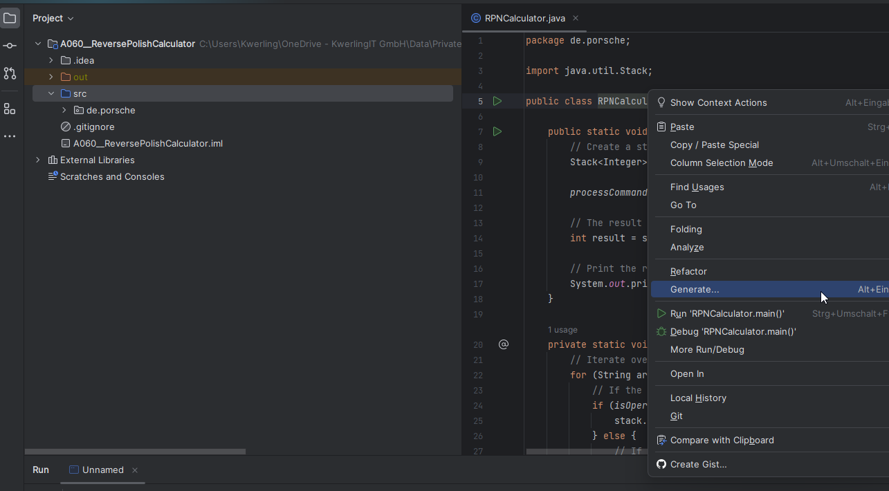
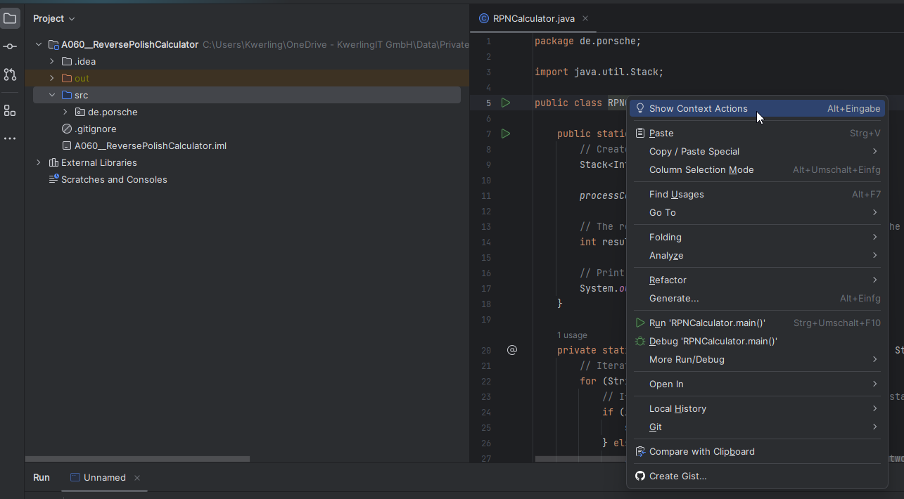
Unit testing - IntelliJ
Part 1
OR

Slide 52
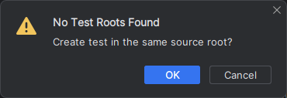
Unit testing - IntelliJ
Part 2

Slide 53
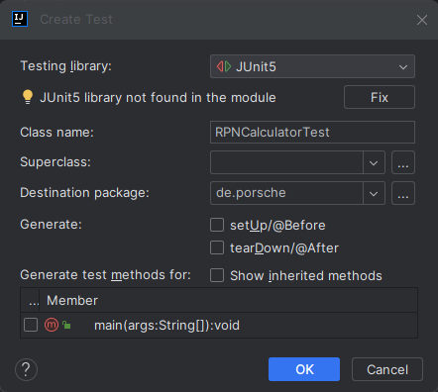
Unit testing - IntelliJ
Part 3
Use Junit 5
Fix it (see next slide)
Generate setup / teardown

Slide 54
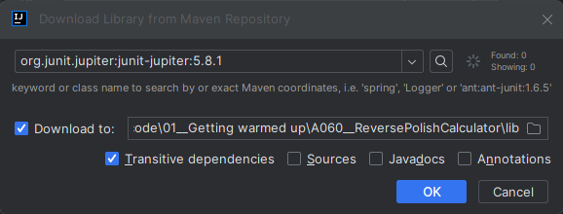
Unit testing - IntelliJ
Part 4

Slide 55
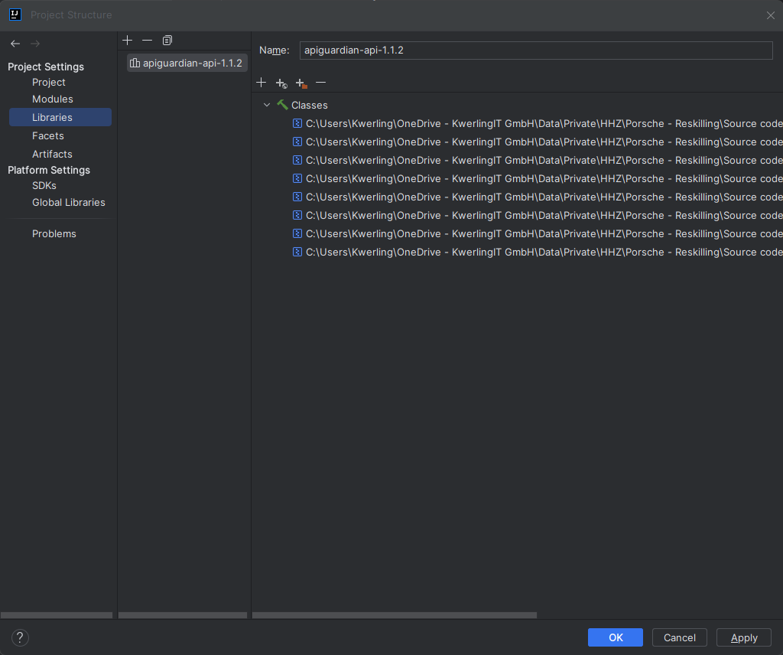
Unit testing - IntelliJ
Part 5

Slide 56
Unit testing - IntelliJ
Part 5
package de.porsche; import static org.junit.jupiter.api.Assertions.*; class RPNCalculatorTest { @org.junit.jupiter.api.BeforeEach void setUp() { } @org.junit.jupiter.api.AfterEach void tearDown() { } @org.junit.jupiter.api.Test void someTest() { } }

Slide 57
Unit testing
There are a number of Assert-Methods supporting the testing. Examples: There are a number of more Assert-Methods, but these 3 should get is going.
Assertion | Explanation
assertEquals( exp, act [, optionalMsg]) | exp is required to be the same as act
assertTrue( cond [, optionalMsg]) | cond is required to be true
assertNotNull( obj [, optionalMsg]) | obj is required to not be null

Slide 58
Exercise A060, part 2
Write some unit tests for the different methods of RPNCalculator.
In order to do so it is much better to have the methods of RPNCalculator as non-static – Refactor, if you have the methods all static as it is in the code shown a couple of slides before.

Slide 59
Reverse polish notation (UPN)
Part 1
package de.porsche; import java.util.Stack; public class RPNCalculator { public static void main(String[] args) { RPNCalculator rpnCalculator = new RPNCalculator(); int result = rpnCalculator.processCommandLineParams(args); // Print the result to the console System.out.println("The result is: " + result); }

Slide 60
Reverse polish notation (UPN)
Part 2
int processCommandLineParams(String[] args) { // Create a stack to store the operands Stack<Integer> stack = new Stack<>(); // Iterate over the command line parameters for (String arg : args) { // If the argument is an operand, push it onto the stack if (isOperand(arg)) { stack.push(Integer.parseInt(arg)); } else { // If the argument is an operator, pop the top two elements of the stack, perform the operation, and push the result back onto the stack doCalculation(stack, arg); } } // The result of the calculation is now on the top of the stack return stack.pop(); }

Slide 61
Reverse polish notation (UPN)
Part 3
void doCalculation(Stack<Integer> stack, String arg) { int operand2 = stack.pop(); int operand1 = stack.pop(); int result = performOperation(arg, operand1, operand2); stack.push(result); } boolean isOperand(String arg) { // An operand is a string that does not contain any of the following characters: +, -, *, / return !arg.contains("+") && !arg.contains("-") && !arg.contains("*") && !arg.contains("/"); }

Slide 62
Reverse polish notation (UPN)
Part 4
int performOperation(String operator, int operand1, int operand2) { // Perform the specified operation on the two operands and return the result switch (operator) { case "+": return operand1 + operand2; case "-": return operand1 - operand2; case "*": return operand1 * operand2; case "/": return operand1 / operand2; default: throw new IllegalArgumentException("Unknown operator: " + operator); } } }

Slide 63
Reverse polish notation (UPN) TEsts
Part 1
package de.porsche; import org.junit.jupiter.api.Test; import static org.junit.jupiter.api.Assertions.*; import java.util.EmptyStackException; import java.util.Stack; class RPNCalculatorTest { RPNCalculator rpnCalculator = null; @org.junit.jupiter.api.BeforeEach void setUp() { rpnCalculator = new RPNCalculator(); } @org.junit.jupiter.api.AfterEach void tearDown() { rpnCalculator = null; }

Slide 64
Reverse polish notation (UPN) TEsts
Part 2
@Test public void testIsOperand() { assertTrue( rpnCalculator.isOperand("1")); assertEquals(true, rpnCalculator.isOperand("123")); assertFalse( rpnCalculator.isOperand("+")); assertEquals(false, rpnCalculator.isOperand("-")); assertEquals(false, rpnCalculator.isOperand("*")); assertEquals(false, rpnCalculator.isOperand("/")); } @Test public void testPerformOperation() { assertEquals(3, rpnCalculator.performOperation("+", 1, 2)); assertEquals(1, rpnCalculator.performOperation("-", 2, 1)); assertEquals(4, rpnCalculator.performOperation("*", 2, 2)); assertEquals(2, rpnCalculator.performOperation("/", 4, 2)); }

Slide 65
Reverse polish notation (UPN) TEsts
Part 3
@Test public void testProcessCommandLineParams() { String[] args = new String[] { "1", "2", "+" }; assertEquals(3, rpnCalculator.processCommandLineParams(args)); args = new String[] { "2", "3", "*", "4", "+" }; assertEquals(10, rpnCalculator.processCommandLineParams(args)); } @Test public void testProcessCommandLineParams_InvalidOperator() { String[] args = new String[] { "1", "2", "%" }; assertThrows(IllegalArgumentException.class, () -> { rpnCalculator.processCommandLineParams(args); }); }

Slide 66
Reverse polish notation (UPN) TEsts
Part 4
@Test public void testProcessCommandLineParams_OneOperand() { String[] args = new String[] { "1" }; assertEquals(1, rpnCalculator.processCommandLineParams(args)); } @Test public void testDoCalculation() { Stack<Integer> stack = new Stack<>(); stack.push(1); stack.push(2); rpnCalculator.doCalculation(stack, "+"); assertEquals(3, stack.pop()); }

Slide 67
Reverse polish notation (UPN) TEsts
Part 5
@Test public void testDoCalculation_EmptyStack() { Stack<Integer> stack = new Stack<>(); assertThrows(EmptyStackException.class, () -> { rpnCalculator.doCalculation(stack, "+"); }); } @Test public void testDoCalculation_OneOperand() { Stack<Integer> stack = new Stack<>(); stack.push(1); assertThrows(EmptyStackException.class, () -> { rpnCalculator.doCalculation(stack, "+"); }); } }

Slide 68
Reverse Polish Notation calculator
Project name | Explanation
A059 … | RPN Calculator with Classes and Interfaces
A060 … | RPN Calculator (almost) procedurally
A061 … | Enhanced RPN Calculator with Classes: 1 Level If Statement Comparison Operators: < <= > >= = == Commands: . D. DUP DROP
A062 … | Enhanced RPN Calculator with Classes: Nested If Statements Commands: ." " CR
A063 … | Enhanced RPN Calculator with Classes: Nested For loops Commands: SP TB I I-(1..5)

Slide 69
Reverse Polish Notation Commands
Command | Explanation
1 10 <= If <commands> Else <commands> Then | Compare 1 <= 10 Put result (0=>false, other value0>true) on stack If true run <commands> Else run <commands> End of if statement

Slide 70
Reverse Polish Notation Commands
Command | Explanation
1 dup 10 <= If 5 <= If <commands> Then <commands> Else <commands> Then | Of course, If statements can be nested

Slide 71
Reverse Polish Notation Commands
Command | Explanation
11 1 Do <commands> Loop | Limit Index Start For Loop Run <commands> End For Loop The Loops runs from one (index) up in steps of 1 to 10. The limit is is 1 greater than the last loop Value

Slide 72
Reverse Polish Notation Commands
Command | Explanation
11 1 Do 11 1 Do <commands> Loop <commands> Loop | For Loops can be nested, too

Slide 73
Reverse Polish Notation Commands
Command | Explanation
11 1 Do ." Run # " I . CR <commands> Loop | I Puts the index (running counter of the For Loop) onto the stack. This is different from FORTH: I-1, I-2, I-3, I-4 and I-5 Allow to access the index variables of nested For Loops (see example on next page)

Slide 74
Reverse Polish Notation Commands
Command | Explanation
11 1 Do 11 1 Do I I-1 * . Loop Loop | Print the results of the multiplication table ("Kleines 1 mal 1")

Slide 75
Reverse Polish Notation Commands
Command | Explanation
11 1 Do 11 1 Do I I-1 * . Loop Loop | Print the results of the multiplication table ("Kleines 1 mal 1")

Slide 76
Reverse Polish Notation calculator
Further enhancements can be added as an exercise:
While or Repeat-Until loops
Register to store values. Ex: Sto-A Rcl-A AddTo-A SubFrom-A (Registers: A – Z) For improvement allow for flexible (multi-chars) names for registers.
Other mathematical functions
Add new Word dynamically – These are similar to functions in other languages
Try to get inspiration from the FORTH programming language. Most of the constructs implemented are close to or exactly like their counterparts in FORTH.

Slide 77
Java Access Modifiers
Modifier | Access Scope | Description | Example
public | Everywhere | Can be accessed from anywhere | public void myMethod()
private | Within the class only | Can only be accessed within the class | private void myPrivateMethod()
protected | Within the package and subclasses | Can be accessed within the package and by subclasses in another package | protected void myProtectedMethod()
No modifier | Packag-private (default) | Can be accessed within the package | void myDefaultMethod()

Slide 78
Java access modifier
Access modifier | Within class | Within package | Outside package by subclass only | Outside package
Private | Yes | No | No | No
Default | Yes | Yes | No | No
Protected | Yes | Yes | Yes | No
Public | Yes | Yes | Yes | Yes
Reference: Java Point

Slide 79
Package (Java) vs namespace (C#)
Java | C#
Packages are used to organize and group related classes, interfaces, and other types. They provide a hierarchical structure that defines the code's namespace and prevents naming conflicts between classes with the same name. | Similar to packages in Java, namespaces in C# use a hierarchical approach to organize code and avoid naming conflicts. They provide a logical grouping of classes, interfaces, and other types and define the code's namespace.

Slide 80
Features of Package & Namespace
Feature | Package (Java) | Namespace (C#)
Physical organization | Packages and their structure are mirrowed in the directory structure in the filesystem | Namespaces have no direct correspondence to the filesystem structure
Visibility | Classes within a package can access other classes within the same package by default | Classes within a namespace can access other classes within the same namespace by default
Access modifiers | Access modifiers (public, private, protected, internal) can be used to control the visibility of class members within a package | Access modifiers (public, private, protected, internal) can be used to control the visibility of class members within a namespace
Naming conventions | Packages typically follow the reverse domain name convention (e.g., com.example.myproject) | Namespaces typically do not follow a specific convention, but it is recommended to use a consistent and meaningful naming scheme

Slide 81
Module B Networking

Slide 82
Content
Sockets
Rest(ful) APIs
Message Bus

Slide 83
Sockets
Communication end points
Logical constructs – there is no physical representation
The OS provides a little over 65500 Sockets (why that number?)
Well known sockets are numbered up to 1024 (again, why that number?)

Slide 84
Sockets
Examples for well known sockets:
Socket number | Protocol served
20 | FTP
22 | SSH
25 | SMTP
53 | DNS
80 | HTTP
443 | HTTPS
…

Slide 85
Sockets
For communicating over a network one needs two types of programs:
Server This program waits for connections and services them
Client This program initiates the connection and uses the service of the server program

Slide 86
Sockets
Part 1
Single Connection Server example
How it works:
Starts
Listens on the server socket
When connected
Reads incoming message
Writes message back
Closes socket
public class EchoServer { private ServerSocket serverSocket; private Socket connectionSocket; private PrintWriter out; private BufferedReader in; public void start(int port) throws IOException { serverSocket = new ServerSocket(port); connectionSocket = serverSocket.accept(); out = new PrintWriter(connectionSocket.getOutputStream(), true); in = new BufferedReader(new InputStreamReader(connectionSocket.getInputStream())); String str = in.readLine(); out.println("Echo: " + str); } public void stop() throws IOException { in.close(); out.close(); connectionSocket.close(); serverSocket.close(); } }

Slide 87
Sockets
Part 2
Here is the Main class for the server
It instantiates the EchoServer class
It starts listening on port 7788
When server is finished it stops all server activities
package de.porsche; import java.io.IOException; public class Main { public static void main(String[] args) { EchoServer server=new EchoServer(); try { server.start(7788); server.stop(); } catch (IOException e) { System.err.println(e.getMessage()); } } }

Slide 88
Sockets
Part 1
Single Connection Client example
How it works:
Build up connection to server
Sends its message
Receives back answer from server
Closes connection
public class EchoClient { private Socket clientSocket; private PrintWriter out; private BufferedReader in; public void startConnection(String ip, int port) throws IOException { clientSocket = new Socket(ip, port); out = new PrintWriter(clientSocket.getOutputStream(), true); in = new BufferedReader(new InputStreamReader(clientSocket.getInputStream())); System.out.println("Server is listening at port:" + clientSocket.getPort()); } public String sendMessage(String msg) throws IOException { out.println(msg); String resp = in.readLine(); return resp; } public void stopConnection() throws IOException { in.close(); out.close(); clientSocket.close(); } }

Slide 89
Sockets
Part 2
Here is the Main class for the client
It sets the port to 7788 on the local machine and establishes the connection
The answer received from the server is printed
package de.porsche; import java.io.IOException; public class Main { public static void main(String[] args) { EchoClient client = new EchoClient(); try { client.startConnection("127.0.0.1", 7788); String response = client.sendMessage("hello server"); System.out.println(response); client.stopConnection(); } catch (IOException e) { System.err.println(e.getMessage()); } } }

Slide 90
Sockets
How can a server serve multiple connections at the same time?
How to know which socket to pick for a server? How to verify if it is free?
How to connect to a server which ip-address & socket I do not know?

Slide 91
Exercises
Take the server & client code and get it to work on your computer
Enhance the server, so that it will not end processing after just one connection. Maybe include the possibility of a command, which, when sent will stop the server.
Use your client to connect to a server an another computer.

Slide 92
Restrictions of the code
The server shown here is a single connection server.
Connections can only be established when there is no existing one
For a multi-connection server one needs to make use of threads
The concepts still remain the same:
The server is listing on a port on a computer for client connections
The client connection is established
The client is served
The connection get closed when the server is done

Slide 93
Restful APIs – Web Services
In the following slides we look at REST clients.
Reasoning for it:
It is by far more likely that you will have to connect to a REST API than that you have to write one
One can do REST APIs in Java, but often another technology is used (Ex.: JavaScript)
Even in Java there are many libraries / tools to do REST APIs

Slide 94
Restful APIs – Web Services
As Restful API for all our clients we use https://postman-echo.com
This is a freely available REST API on the internet The examples use the Http-Client, which is contained in the JDK. Again, there are man other alternatives available.

Slide 95
Restful APIs – Web Services
What is Rest?
Http based
Stateless
Rest request:
Http-Verb: GET, POST, PUT, DELETE (to name the more common ones)
Header: Accept field (Response type), Authorization …
Path to the resource (Ex.: mysrv.com/Customers/9/Orders/17
Message body (optional): Additional data

Slide 96
Restful APIs – Web Services
How to do a Http-Request?
HttpRequest uses the builder pattern
One needs to make use of multiple methods of the class to construct the request: HttpRequest request = HttpRequest.newBuilder() .uri( new URI(„https://postman-echo.com/get“) ) .GET() .build();

Slide 97
Restful APIs – Web Services
Execute the request:
It is the HttpClient, which executes the request and provides the response: HttpClient client = HttpClient.newHttpClient(); HttpResponse<String> response = client.send(request, BodyHandlers.ofString());
The result is found in response.body

Slide 98
Exercise B030
Write a Java program, which can do the following:
Retrieve the response from the Postman-Echo GET web service and print it
Retrieve and print your IP-address from the Postman-Echo IP web service
Use the Postman-Echo POST web service. Read up on HttpClient and the Postman-Echo web site in order to write the code.

Slide 99
Restful APIs – Web Services
Part 1
Very simple Main class
Everything happens inside of the PostmanEchoClient class
There is even no need to have the instance assigned to a local variable
package de.porsche; public class Main { public static void main(String[] args) { new PostmanEchoClient(); } }

Slide 100
Restful APIs – Web Services
Part 2
It is the constructor calling all the methods in the class
package de.porsche; import java.io.IOException; import java.net.URI; import java.net.URISyntaxException; import java.net.http.HttpClient; import java.net.http.HttpRequest; import java.net.http.HttpResponse; public class PostmanEchoClient { public PostmanEchoClient() { HttpClient client = HttpClient.newHttpClient(); try { peGet(client); peGetWithParameter(client); peMyIP(client); pePost(client); } catch (Exception ex) { System.err.println(ex.getMessage()); ex.printStackTrace(); } }

Slide 101
Restful APIs – Web Services
Part 3
printResult is a helper routine, which is used by every other method.
As it does not provide any service outside the class it could (or should?) have been made private.
void printResult( String methodName, HttpResponse<String> response) { System.out.println(methodName + ": " + response.body()); System.out.println(methodName + " status code: " + response.statusCode()); System.out.println(); } void peGet(HttpClient client) throws URISyntaxException, IOException, InterruptedException { HttpRequest request = HttpRequest.newBuilder() .uri( new URI("https://postman-echo.com/get") ) .GET() .build(); HttpResponse<String> response = client.send(request, HttpResponse.BodyHandlers.ofString()); printResult("peGet", response); }

Slide 102
Restful APIs – Web Services
Part 4
Another two GET requests
void peGetWithParameter(HttpClient client) throws URISyntaxException, IOException, InterruptedException { HttpRequest request = HttpRequest.newBuilder() .uri( new URI("https://postman-echo.com/get?Eins=1") ) .GET() .build(); HttpResponse<String> response = client.send(request, HttpResponse.BodyHandlers.ofString()); printResult("peGetWithParameter", response); } void peMyIP(HttpClient client) throws URISyntaxException, IOException, InterruptedException { HttpRequest request = HttpRequest.newBuilder() .uri( new URI("https://postman-echo.com/ip") ) .GET() .build(); HttpResponse<String> response = client.send(request, HttpResponse.BodyHandlers.ofString()); printResult("peMyIP", response); }

Slide 103
Restful APIs – Web Services
Part 5
POST requests require special handling recording the data to be posted.
void pePost(HttpClient client) throws URISyntaxException, IOException, InterruptedException { HttpRequest request = HttpRequest.newBuilder() .uri( new URI("https://postman-echo.com/post") ) .headers("Content-Type", "text/plain;charset=UTF-8") .POST(HttpRequest.BodyPublishers .ofString("Greeting to the Postman Web Service.")) .build(); HttpResponse<String> response = client.send(request, HttpResponse.BodyHandlers.ofString()); printResult("pePost", response); } }

Slide 104
Docker
Docker is a lightweight, portable containers for packaging and running applications

Slide 105
Docker
Feature | Explanation
Containerization | Packages applications and their dependencies into self-sufficient units called containers.
Lightweight | Containers share the host operating system's kernel, making them more efficient than VMs.
Portability | Containers run consistently across different environments, from local machines to cloud platforms.
Isolation | Containers are isolated from each other, preventing conflicts and resource contention.
Scalability | Containers can be easily scaled up or down based on demand.
Reproducibility | Applications deployed in containers are always deployed in the same environment, ensuring reproducibility.
Automation | Provides tools for automating the build, deployment, and management of containers.
Popular ecosystem | Has a large and active community with a wide range of tools and integrations.
Wide adoption | Used by millions of developers and organizations worldwide.

Slide 106
Comparison of Docker with VMs
Feature | Docker | Virtual Machine
Resource usage | Lightweight, shares the host kernel | More resource-intensive, runs its own operating system
Portability | Highly portable, runs consistently across environments | Less portable, may require environment configuration
Isolation | Isolated from each other, preventing conflicts | Isolated from each other (more overhead, separate OS)
Startup time | Fast startup time | Slower startup time due to OS initialization
Scalability | Easily scalable up or down | Scalable, but may require more resource management
Reproducibility | High reproducibility due to consistent environment | Reproducibility depends on underlying OS
Complexity | Simpler to manage and deploy | More complex to manage and deploy
Ecosystem | Large and active ecosystem | Wide range of tools and integrations

Slide 107
Message Bus
Assumptions for the following slides:
Docker Desktop is installed on your computer With Docker Desktop the command line interface for Docker is included, too. All the needed docker activities in this presentation can be executed this way. Please refer to Appendix A for instructions on how to install Docker Desktop.

Slide 108
Message Bus
Install RabbitMQ on your machine Command line: docker pull rabbitmq
This will take a little while

Slide 109
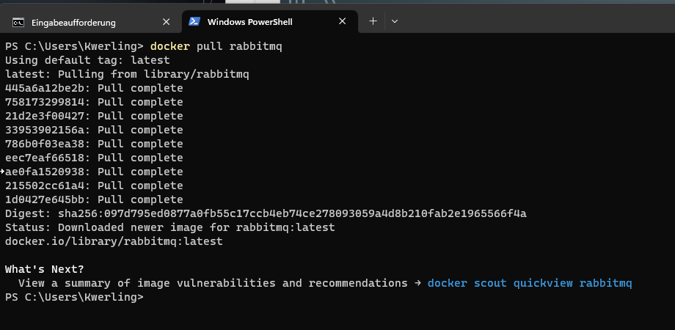
Message bus

Slide 110
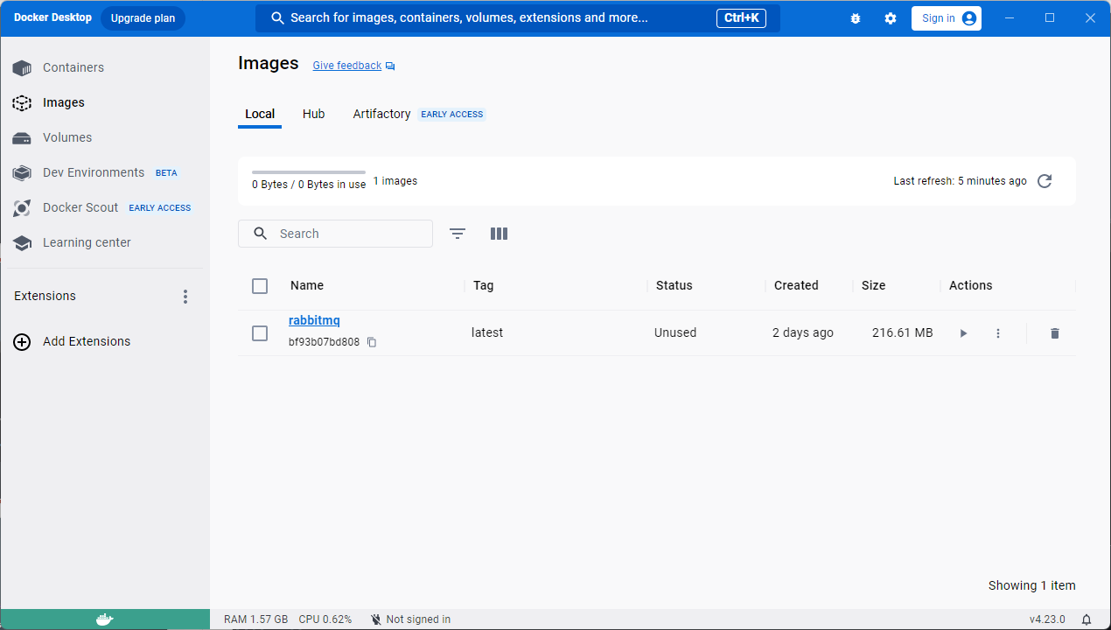
Message bus

Slide 111
Message bus
Features:
Applications communicate through messages via the bus
The bus architecture contains a message broker as central element
The broker receives, routes, and delivers the messages
Because of the broker the message sender / receiver are only loosely coupled
The communication happens asynchronously

Slide 112
Message Bus
Either | Or | Or
Sender | Producer | Publisher
Receiver | Consumer | Subscriber

Slide 113
Message Bus
How to picture a message bus?
Message Bus
Message Bus
Application 2
Application 2
Application 3
Application 3
Application 1
Application 1
Computer 1
Computer 2

Slide 114
Message Bus
Application 2
Application 1
How is it technically done?
Application 3
Computer 1
Message Broker
Application
Application 2
Application 1
Application 3
Computer
Computer 2

Slide 115
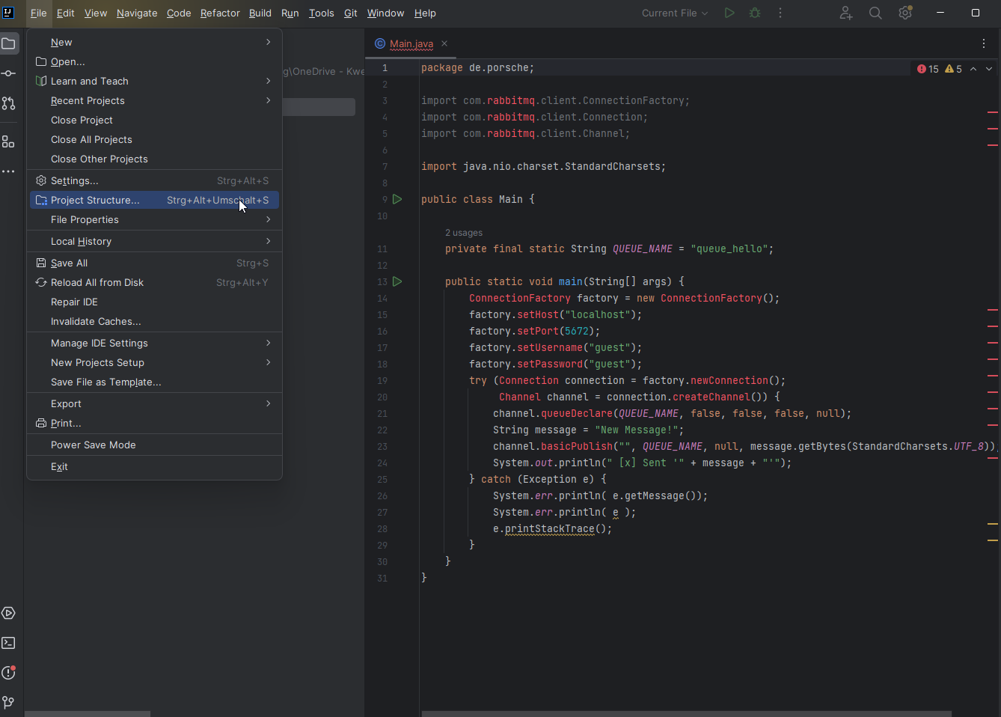
Message Bus
In order to run the RabbitMQ Consumer and Producer code, the RabbitMQ java library needs to be added to the project.
File -> Project Structure

Slide 116
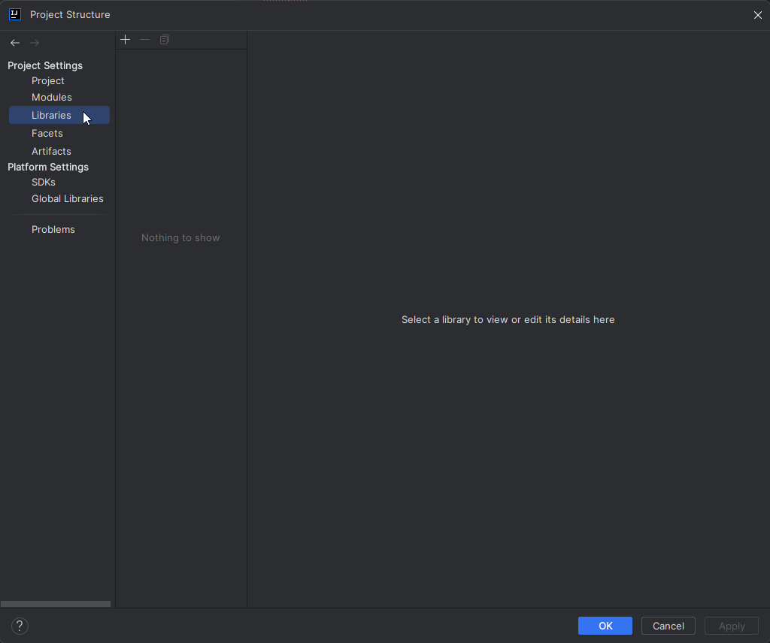
Message Bus
Libraries

Slide 117
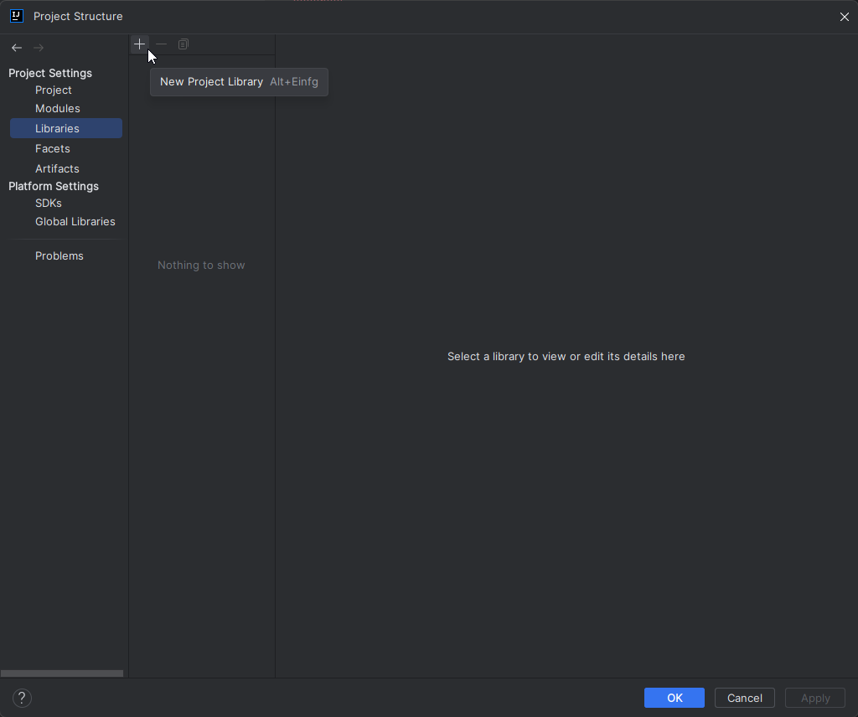
Message Bus
Add ( + ) button

Slide 118
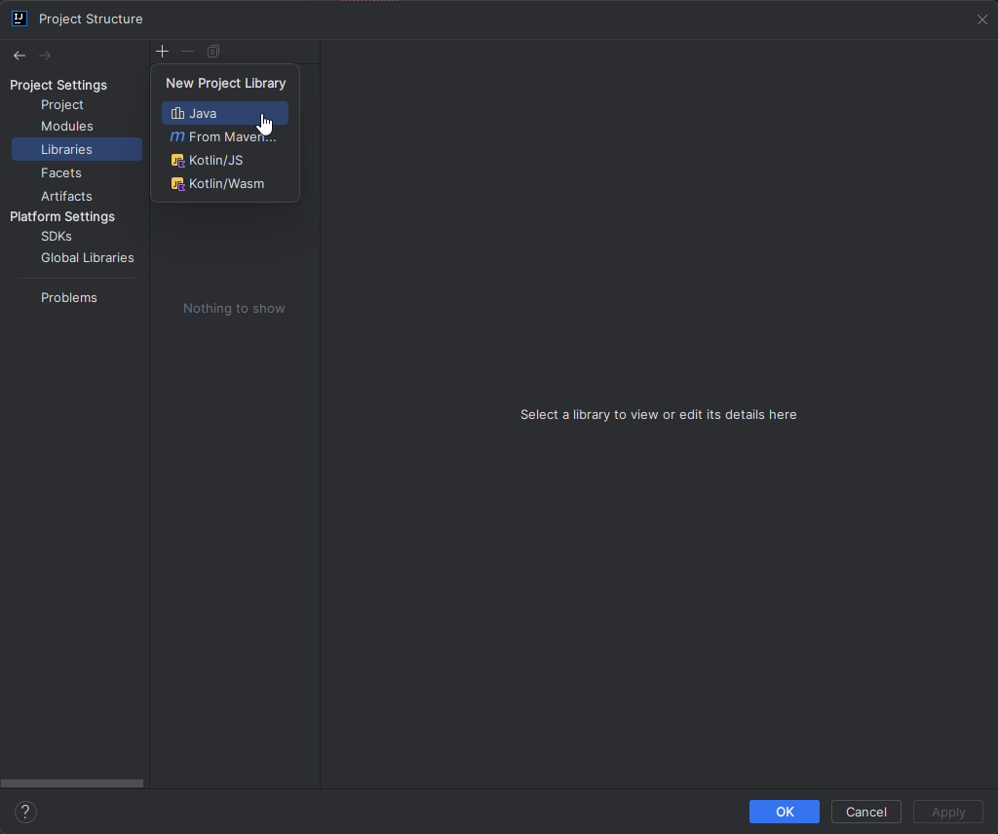
Message Bus
Choose Jave library

Slide 119
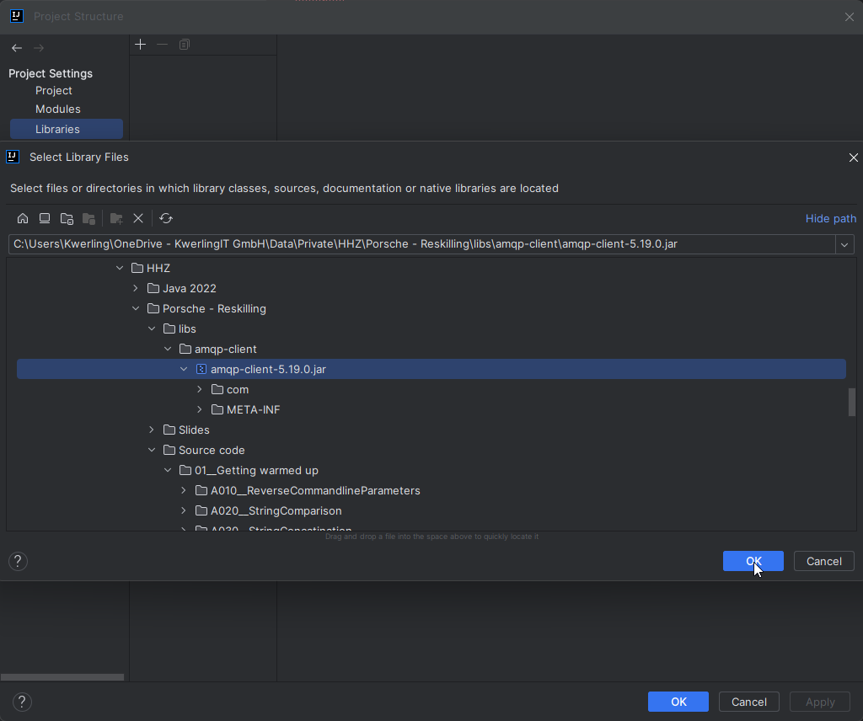
Message Bus
The repository contains a libs directory on the same level as the source code directory.
In that directory, there is the amqp directory
In that directory is the library needed
Libraries

Slide 120
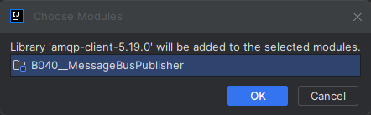
Message Bus

Slide 121
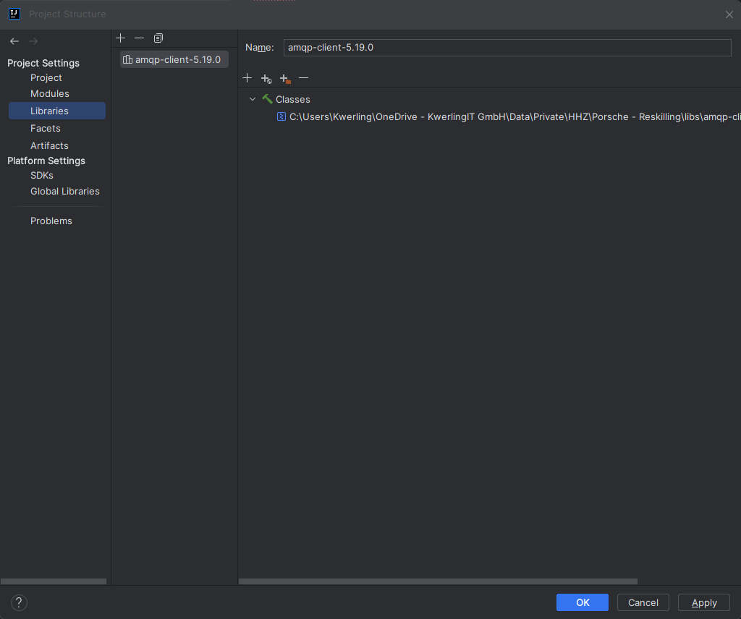
Message Bus

Slide 122
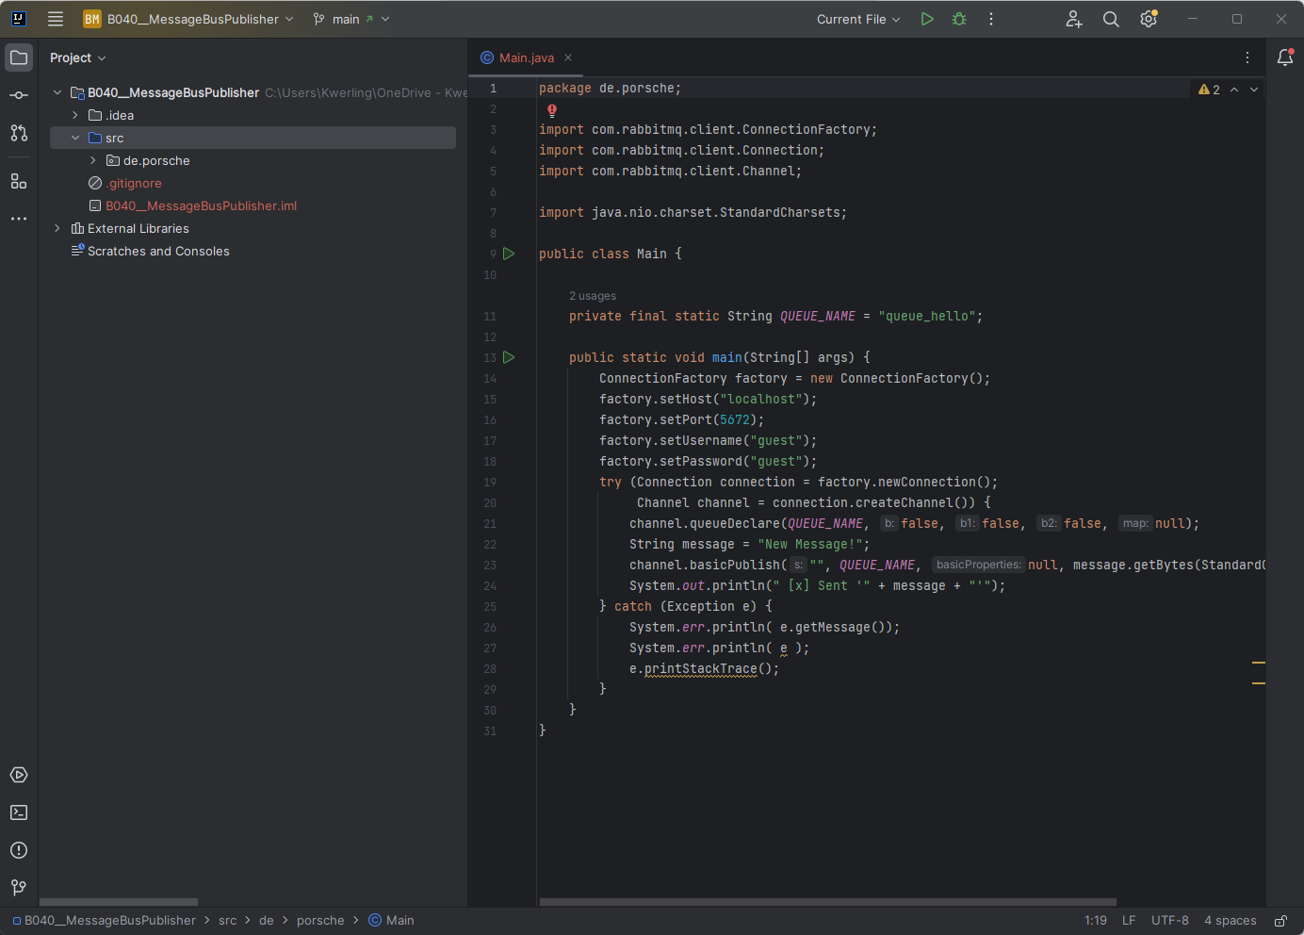
Message Bus
All classes and methods should be known now.

Slide 123
Message Bus
First part of a simple publisher code.
Every message is published into a queue.
package de.porsche; import com.rabbitmq.client.ConnectionFactory; import com.rabbitmq.client.Connection; import com.rabbitmq.client.Channel; import java.nio.charset.StandardCharsets; public class Main { private final static String QUEUE_NAME = "queue_hello";

Slide 124
Message Bus
Connect to the RabbitMQ broker
Authenticate
Connect to queue
Publish
public static void main(String[] args) { ConnectionFactory factory = new ConnectionFactory(); factory.setHost("localhost"); factory.setPort(5672); factory.setUsername("guest"); factory.setPassword("guest"); try (Connection connection = factory.newConnection(); Channel channel = connection.createChannel()) { channel.queueDeclare(QUEUE_NAME, false, false, false, null); String message = "New Message!"; channel.basicPublish("", QUEUE_NAME, null, message.getBytes(StandardCharsets.UTF_8)); System.out.println(" [x] Sent '" + message + "'"); } catch (Exception e) { System.err.println( e.getMessage()); System.err.println( e ); e.printStackTrace(); } } }

Slide 125
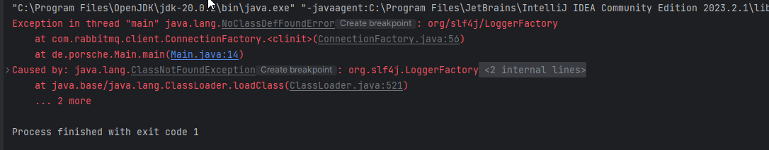
Message bus
No compilation issues
But when trying to run the error to the right appears
Reason is, that there is a dependency on the slf4j libraries for logging
Add them to the project

Slide 126
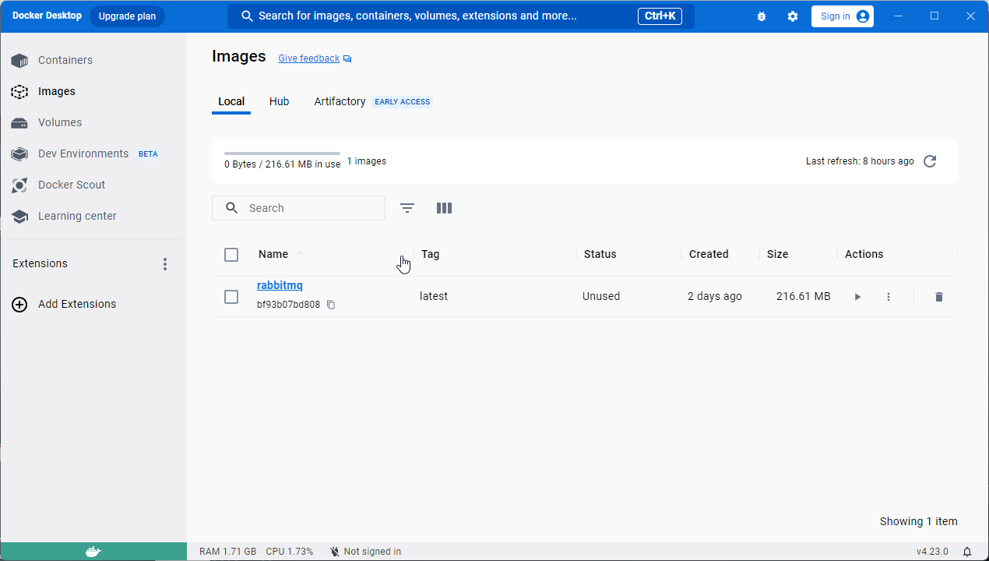
Message Bus
Now it is time to start RabbitMQ
Click the run button

Slide 127
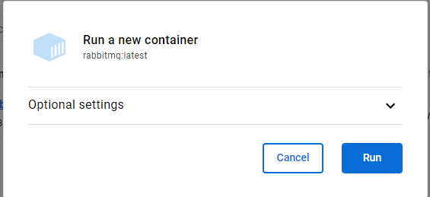
Message Bus
Click on Optional settings

Slide 128
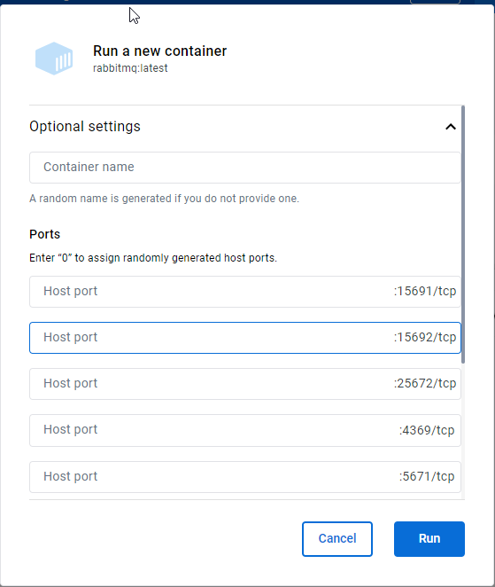
Message Bus
Enter the same local ports as RabbitMQ uses

Slide 129
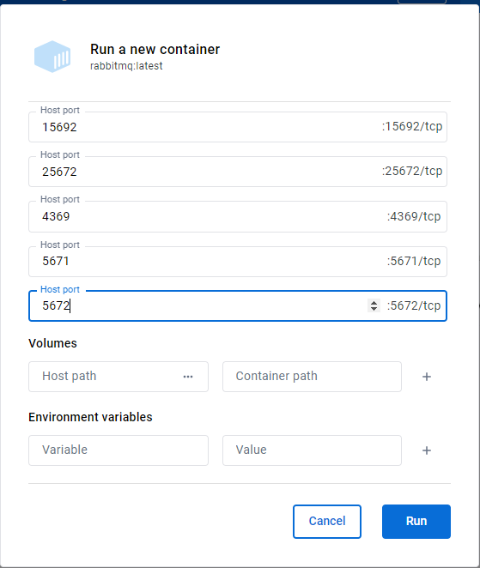
Message Bus
Continue – leave the other fields empty
Run

Slide 130
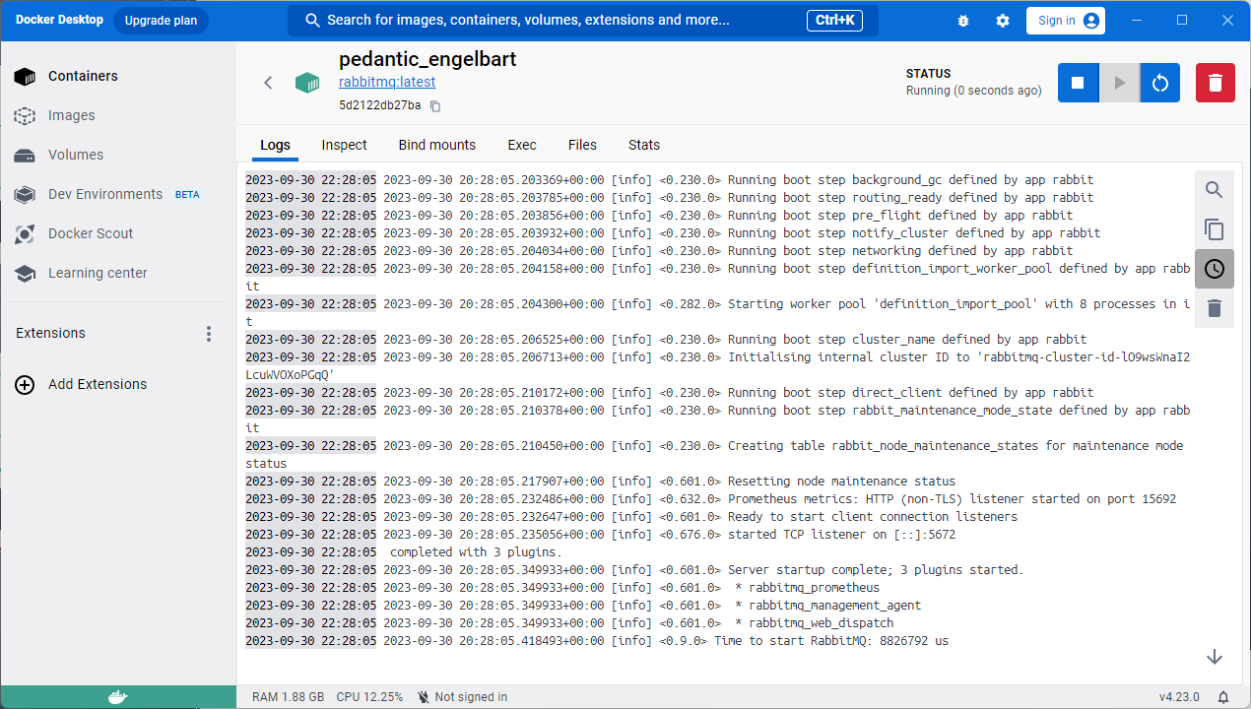
Message Bus
You'll see the log information from the RabbitMQ startup.
CAREFUL: You might run into problems with your firewall -> allow access for the docker container

Slide 131
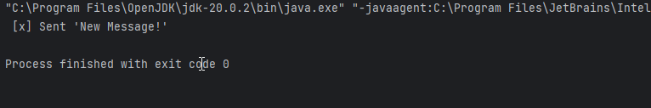
Message Bus
You should see this information when the program runs successfully

Slide 132
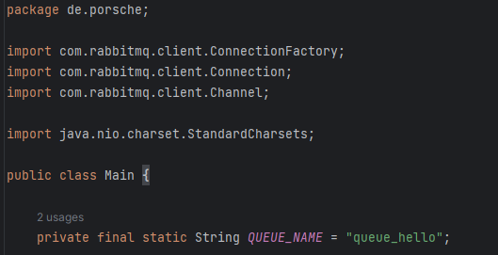
Message bus
Here is the first part of the Consumer code.
The message queue of the consumer must be spelled exactly the same was as the one used in the publisher

Slide 133
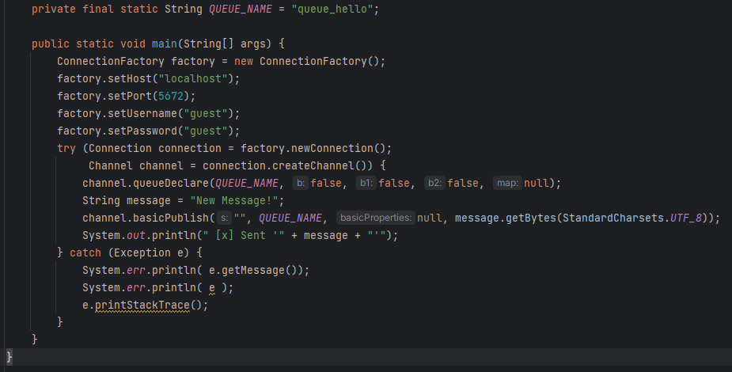
Message bus
This consumer runs forever

Slide 134
Exercise: Message bus
Get both, consumer and producer up and running
Refactor the producer so, that the message is taken from the command line
Try to connect to a RabbitMQ broker of your peers
Play a little with different queue names
Try to setup a chat application with one of the other groups (see next slide: Getting keyboard input in console app)

Slide 135
Getting keyboard input in console app
Use the Console class to read keyboard input
package de.porsche; import java.io.Console; public class Main { public static void main(String[] args) { Console con = System.console(); if( null == con ) { System.err.println("Console read access unavailable!"); } else { System.out.print("Enter some user input: "); String input = System.console().readLine(); System.out.printf("You entered: %s", input); } } }

Slide 136
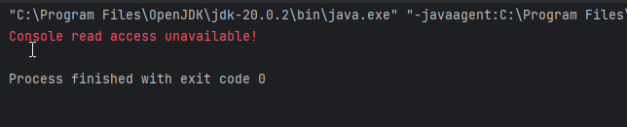
Getting keyboard input in console app
Most likely there will be no access to the console from within IntelliJ
Goto the project directory and then to the out\production\B060__ReadingKeyboardInputInConsoleApp directory
Run java –cp . de.porsche.Main

Slide 137
Module c Databases

Slide 138
Databases – Table of content
Relational Databases
SQL
JDBC
ORM
KV-DB

Slide 139
Databases
Feature | Relational / SQL Database | No(n)-SQL Database
Data type | Structured | Structured / unstructured
Data storage | Tables | document, key-value, wide-column, and graph
Integrity / reliability | ACID: Atomicity Consistency Isolation Durabilty | Some do, others don't. There are NoSQL DBs, which sacrifice ACID for speed (wordplay ☺)
Database language | SQL: Data Definition Language (DDL) Data Manipulation Language (DML) Data Control Language (DCL) Data Query Language (DQL) | There is no standard similar to SQL for No-SQL databases. Each Database Management System hast ist own language, may they be similar to each other in cases.

Slide 140
Databases
Feature | Excel | SQL Database
Structure | Rows, which contain attributes in different columns | Records, which contain different attributes. More restrictive with the data stored in each column. Also, there are primary keys.
Data types | Very many different data types are supported, including formulae | Many different data types are supported, but also enforced for the attributes in a record
Relationships | Manually constructed between tables for user formulae | Standard part of SQL. Build very strong and enforced rules.
Queries | (Built-in) formulae | Powerful language, which selects or changes data in tables.

Slide 141
Databases
Suppliers
Id | Integer | PK
CompanyName | String
ContactName | String
City | String
Country | String
Phone | String
Fax | String
Products
Id | Integer | PK
ProductName | String
SupplierId | Integer | FK
UnitPrice | Double
Package | String
IsDiscontinued | Bit
OrderItem
Id | Integer | PK
OrderId | Integer | FK
ProductId | Integer | FK
UnitPrice | Double
Quantity | Integer
Customers
Id | Integer | PK
FirstName | String
LastName | String
City | String
Country | String
Phone | String
Orders
Id | Integer | PK
OrderDate | Date
CustomerId | Integer | FK
TotalAmount | Double

Slide 142
Databases
Suppliers
Id | Integer | PK
CompanyName | String
ContactName | String
City | String
Country | String
Phone | String
Fax | String
Products
Id | Integer | PK
ProductName | String
SupplierId | Integer | FK
UnitPrice | Double
Package | String
IsDiscontinued | Bit
Orders
Id | Integer | PK
OrderDate | Date
CustomerId | Integer | FK
OrderNumber | String
TotalAmount | Double
Customers
Id | Integer | PK
FirstName | String
LastName | String
City | String
Country | String
Phone | String
OrderItem
Id | Integer | PK
OrderId | Integer | FK
ProductId | Integer | FK
UnitPrice | Double
Quantity | Integer

Slide 143
Exercise: C010 - Databases
Run the code in C010__CreateAndFillDB
When it runs without error change the DB_URL to
Verify that in the project directory now there is a subdirectory called testdb and that in that subdirectory is a file called testdb(.mv). This file contains the h2 databas.
static final String DB_URL = "jdbc:h2:./testdb/testdb";

Slide 144
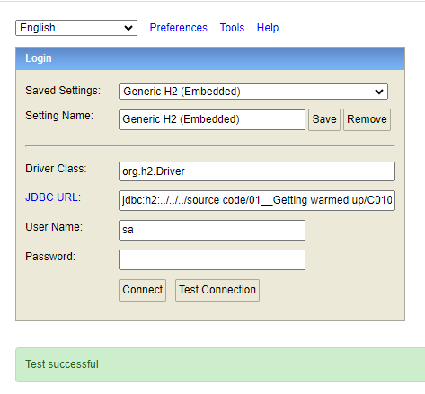
Databases
Goto to the libs/h2/bin directory
Run java -jar h2-2.2.224.jar
A new browser window opens
Enter path to DB (here relative from h2/bin directory)
Verify the correctness of data with "Test Connection"

Slide 145
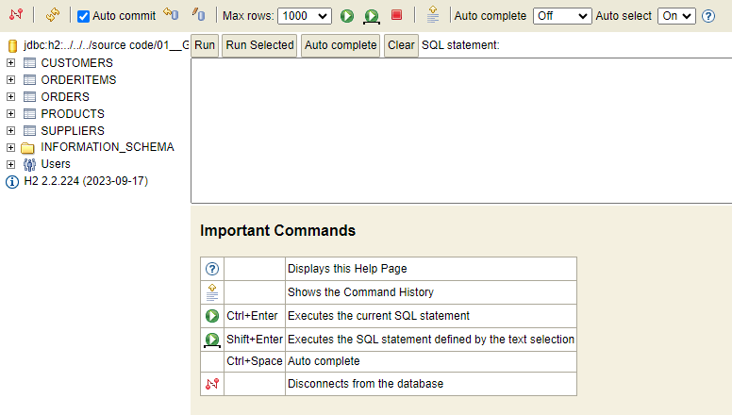
Databases
Here are the tables of the DB
Click "Run" button to execute a SQL statement
Here you enter the SQL statements

Slide 146
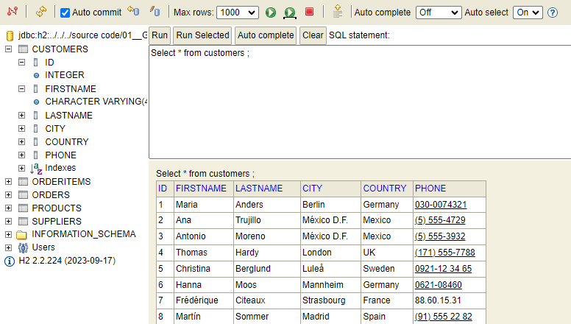
Databases
Details on the attributes of a table
Result of a run query

Slide 147
Databases – Select Statement
Select retrieves data from the database
Select statement part | Explanation
Select | Specifies the columns from the resultset to be returned
From | Specifies the tables to be used in the query, often also how the are joined
Where | Specifies the filter conditions
Group by | Specifies how to group rows in the resultset for running aggregate functions on them
Having | Specifies the filter criteria for the "Group by" groups in the resultset
Order by | Specifies how to sort the rows in the resultset
Limit | Limits the number of rows to be returned from the resultset

Slide 148
Databases – Select Statement
String comparison in conditions:
SQL wildcards: Wildcards are special characters that represent one or more characters
Escaping: Wildcards are escaped by use of a backslash (e.g: '\_' and '\%')
Example: select * from Customers c where c.firstname like '%a%a'
Wildcard character | What it stands for
_ | Underscore: stands for one single character
% | Percent sign: stands for zero or more characters

Slide 149
Databases – Select Statement
select * from Customers c where c.firstname <<comparison>> :
<<comparison>> | Result
= 'Hanna'
Like 'Hanna'
Like 'Ha_na'
= 'Ha_na'

Slide 150
Databases – Select Statement
String comparison with Regex:
Comparison of strings can be done with Regex as well
Example:
select * from Customers c where c.lastname regexp 'M.*[n]+a'

Slide 151
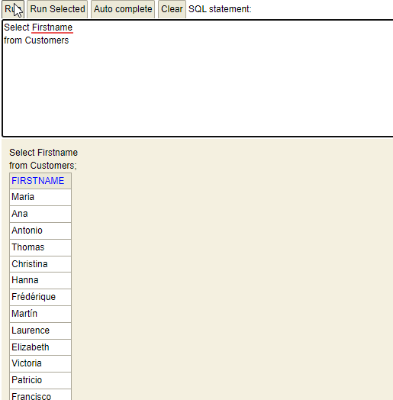
Databases – Select Statement
Lists all first names from the customers table

Slide 152
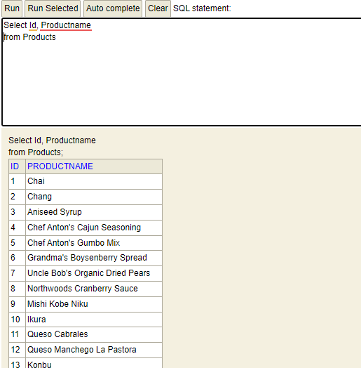
Databases – Select Statement
Lists all products with the internal id from the Products table

Slide 153
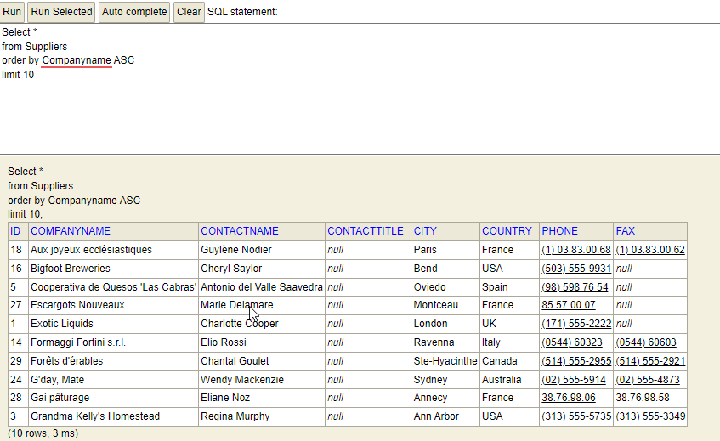
Databases – Select Statement
List the first 10 rows of the supplier table sorted by the supplier name in ascending order

Slide 154
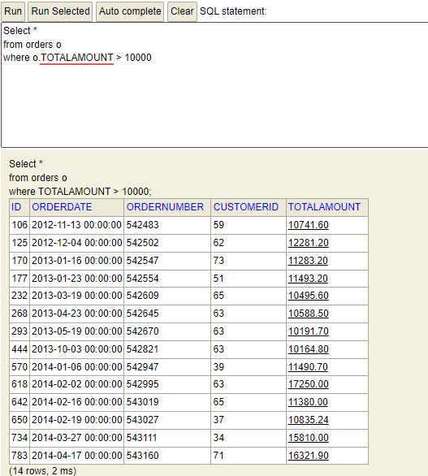
Databases – Select Statement
List all orders where the totalamount is greater than 10000

Slide 155
Databases – Select Statement
These are some aggregate functions:
Aggregate function | Explanantion
count() | Number of rows
min() | Minimum of attribute column in resultset
max() | Maximum of attribute column in resultset
avg() | Average of attribute column in resultset
sum() | Sum of attribute column in resultset

Slide 156
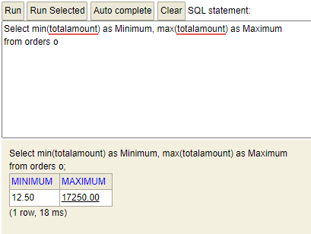
Databases – Select Statement
Display the minimum and maximum Totalamount in Orders
The aggragated functions min and max are here used on all the records in the resultset as there is no group by clause.

Slide 157
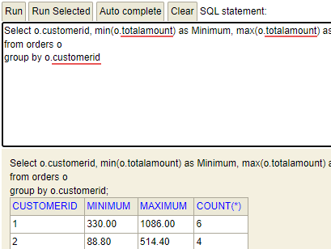
Databases – Select Statement
Display the minimum and maximum totalamount for each customer's orders

Slide 158
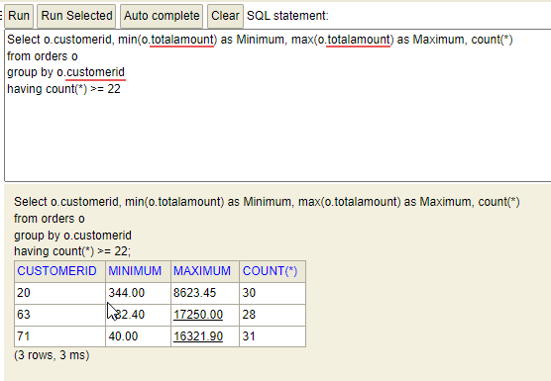
Databases – Select Statement
Display the minimum and maximum totalamount for each customer's orders for all customers with more than 22 orders

Slide 159
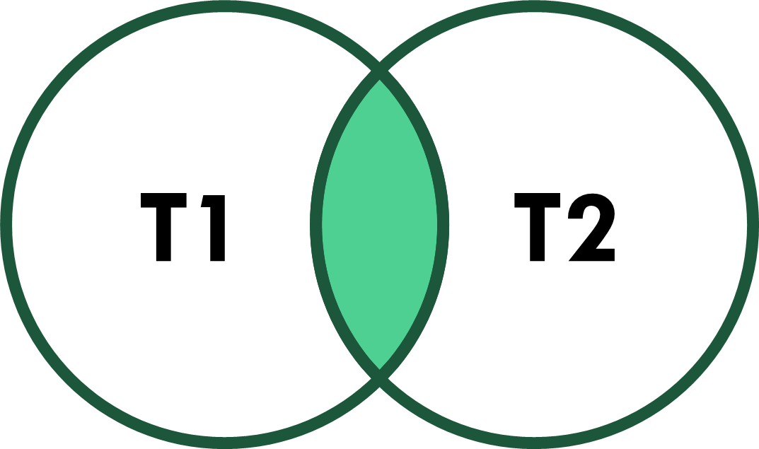
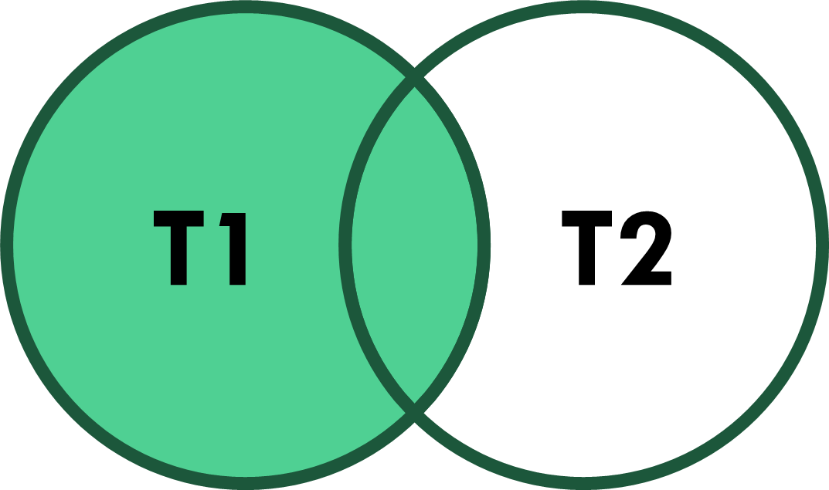
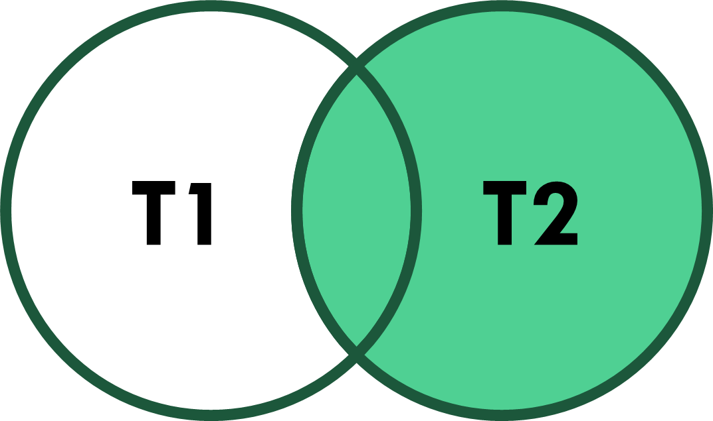
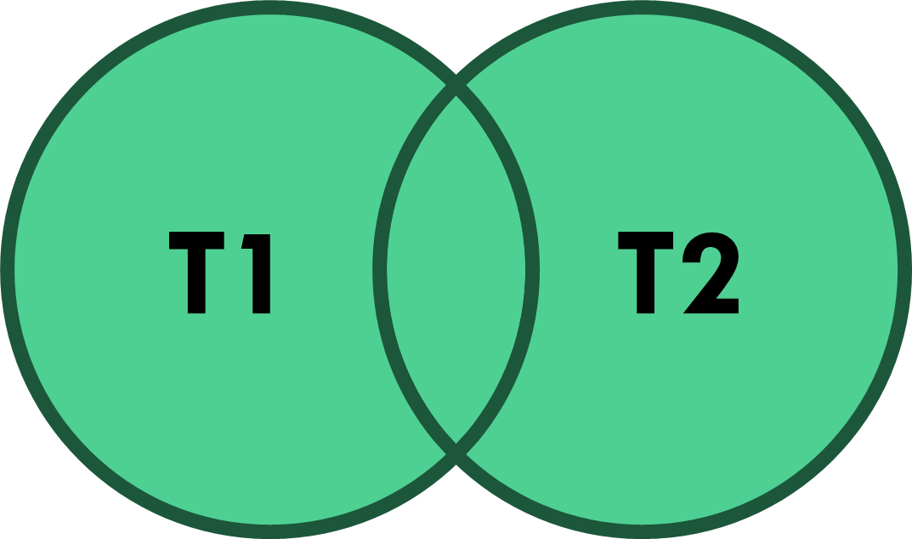
Databases – Select Statement
Type of Join | Explanation
(inner) join | Returns records which have matching values in both tables
left (outer) join | All records from the left table and the matched records from the right table
right (outer) join | All records from the right table and the matched records from the left table
full (outer) join | Returns all the records when there is a match in either table

Slide 160
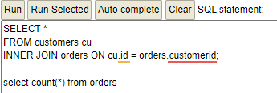
Databases – Select Statement
Only orders with a matching customer for it (Should be all of them)

Slide 161
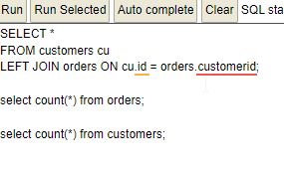
Databases – Select Statement
All customers, even those without orders (Check out how the order data is represented when there is no order for a customer)

Slide 162
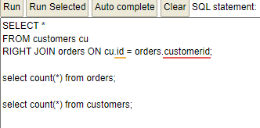
Databases – Select Statement
All the orders, even those without a customer (There better is none without a customer!)

Slide 163
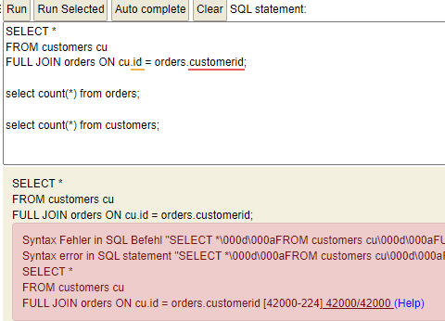
Databases – Select Statement
Funny enough, the H2 SQL dialect does not support FULL JOINs You will have to switch to a different dialect.

Slide 164
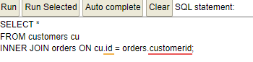
Databases – Select Statement
List all customers, which have placed orders. Since we use the *, not only the customer's attributes, but also the order's attributes are shown

Slide 165
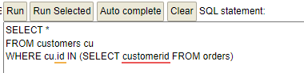
Databases – Select Statement
List all customers, which have placed orders. This is another way, completly without joining tables. This solution uses a sub-select.

Slide 166
Databases – Select Statement
Hangon …… The "Join" version provides 830 result rows, while the "sub-select" version provides 89. WHY is that?

Slide 167
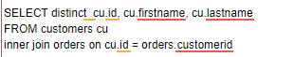
Databases – Select Statement
Modify the "Join" version slightly: Distinct eliminates all duplicate rows in the final resultset

Slide 168
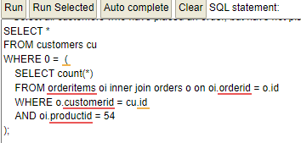
Databases – Select Statement
Just for completeness: Display all customers who have placed an order, but not for the product with the ID 54 The solution is based on a correlated sub-select

Slide 169
Exercises: Databases – Select Statement
Show all products, that are with 100 or more items in stock
Show all orderitems for order #830
Show the first 3 orders with the most orderitems
Show all orderIDs, where the totalamount is different from the sum of the ordervalue of the orderitems
Show all customers without orders

Slide 170
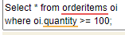
Exercises: Databases – Select Statement
Show all products, that are with 100 or more items in stock

Slide 171
Exercises: Databases – Select Statement
Show all orderitems for order #830

Slide 172

Exercises: Databases – Select Statement
Show the first 3 orders with the most orderitems

Slide 173

Exercises: Databases – Select Statement
Show all orderIDs, where the totalamount is different from the sum of the ordervalue of the orderitems

Slide 174

Exercises: Databases – Select Statement
Show all customers without orders

Slide 175
Databases – Null Value
NULL is the absence of data
Any attribute can be null, if not declared "not null" in the create table statement
NULL is different from an empty string or zero
NULL cannot be compared
To check for NULL use "is [not] null"
To prevent NULL results use coalesce(<attrib>, <value>)
Also, the ifnull(<attrib>, <value>) function can be used

Slide 176
Databases – Null Value
Run "select * from suppliers". Notice, that there are records with a NULL value for a fax number.
Now run "select * from suppliers where fax = null" Explain the resultset.
How could that be done better?

Slide 177
Databases – Transactions
Transactions allow to to treat multiple SQL statements as a single unit of work.
Either all statements within a transaction succeed or none
Databases are often set to auto-commit, which then commits every single statement
If not, transaction start implicitely until they are explicitely finished.
Transactions result in locks in the DB and therefore impact parallel access

Slide 178
Databases – Transactions
Even though transactions start implicitely there are "Begin Transaction" or "Start Transaction" commands
"Commit" finishes a transaction successfully and makes the changes permanent
"Rollback" puts the DB in a state as if the transaction was never run
"Savepoints" are steps in a transaction to which one can "Rollback" to, as long as the transaction has not been finished.

Slide 179
Databases – Select Statement
Here is the order in which a DBMS processes a select statement:
Select statement part | Addtn'l info
From clause | Tables and Join instructions
Where clause | Filters the rows
Group by | Groups the rows of the resultset
Having | Filters the groups according the criteria
Select | Constructs the attributes shown
Order by | Orders the resultset
Limit | Restricts the number of rows in the resultset

Slide 180
Databases – Query in JAVA
Database URL:
Jdbc -> Protocol
h2 -> Driver to use
Rest -> Path to DB (URL)
User name ( sa -> System Admin)
Password (1234 -> Standard (h2)
public class Main { static final String DB_URL = "jdbc:h2:./testdb/testdb"; // static final String DB_URL = "jdbc:h2:mem:test"; // "jdbc:h2:mem:mymemdb:" // "jdbc:h2:./testdb" // "jdbc:h2:///c/temp/testdb" static final String USER = "sa"; static final String PASS = "1234";

Slide 181
Databases – Query in JAVA
The enclosed getConnection ensures that the DB is closed automatically
conn is used for working with the DB
public static void main(String[] args) { try (Connection conn = DriverManager.getConnection(DB_URL, USER, PASS)) { <<SQL Statements to process>> System.out.println("Successfully run the SQL statements."); } catch ( Exception ex ) { System.err.println("ERROR: " + ex.getMessage()); } } }

Slide 182
Databases – Query in JAVA
This is a simple select statement
The results are in rs
The while loop runs through the records
Attribute values can be extracted if the data type is known
final String QUERY = "SELECT * FROM Products where ProductName like 'C%';"; try(Statement stmt = conn.createStatement()) { ResultSet rs = stmt.executeQuery(QUERY); while( rs.next()) { System.out.println("Name: " + rs.getString("productname")); System.out.println("Price: " + rs.getDouble("unitprice")); } }

Slide 183
Databases – Query in JAVA
If the SQL statement stays the same, but the criteria values change between runs one uses: PreparedStatement
The set method replace the ?s with the real value
final String QUERY = "SELECT * FROM Products" + " where ProductName like ? and unitprice > ?;"; try(PreparedStatement ps = conn.prepareStatement(QUERY);) { ps.setString(1, "C" + "%"); ps.setDouble(2, 40.0); ResultSet rs = ps.executeQuery(); while( rs.next()) { System.out.println("Name: " + rs.getString("productname")); System.out.println("Price: " + rs.getDouble("unitprice")); } }

Slide 184
Exercise: Databases – Query in JAVA
Write a Java program, which takes one or two parameters from the command line (Productname and Unitprice).
Use the parameters to run the Select statement from the slides before
Print the resulting lines to the console (No solution will be provided)

Slide 185
Databases – ORM
Object-Relational Mapping (ORM) is an abstraction layer on top of the database layer
It supports mapping of Classes (Objects) to Tables and vice versa
Many ORM support lazy loading for improving performance
Also, caching is supported by many ORM
ORMs support transactions

Slide 186
Databases – ORM Example
This code retrieves all customers
The resultset is mapped into a Java List containing instances of the Customer class.
// Create a new ORM object EntityManager em = EntityManagerFactory.createEntityManager(); // Create a query to retrieve all customers Query query = em.createQuery("SELECT c FROM Customer c"); // Execute the query and get the results List<Customer> customers = query.getResultList(); // Close the ORM object em.close();

Slide 187
Databases – ORM Example
This code adds a new customer to the database.
First one is setting the values in an instance of the customer class
Then a call to persist will store the new customer into the Customer table in the DB
// Create a new ORM object EntityManager em = EntityManagerFactory.createEntityManager(); // Create a new Java object Customer customer = new Customer(); customer.setName("John Doe"); customer.setEmail("john.doe@example.com"); // Save the Java object to the database em.persist(customer); // Close the ORM object em.close();

Slide 188
Databases – ORM Example
Pseudo code on the right
q -> Query cb -> CriteriaBuilder
This way the sql statement can be build step by step.
Query q = cb.createQuery( Student.class ); q.where( cb.greaterThan “studentID“, 423 ); List<Student> lSt = q.execute();

Slide 189
Databases – ORM Advantages
Productivity gain: Writing DB code is much easier
Improved Maintainability
Increased portability

Slide 190
Databases – KV-DB
In a Key-Value DB each record is stored under a key
There is (almost) no assumption on what the data is
Keys are Strings
Depending on the data a record might be a JSON String
KV-DBs are often run in memory and therefore very fast

Slide 191
Databases – KV-DB
In our examples we make use of a KV-DB by the name of MemKV
MemKV holds its data in memory
It can be persistet to and loaded from disk
Anything stored as data needs to be serializable
Primitive datatypes are converted to their correlating class
Data retrieved is always some object, if no specialized getter is used

Slide 192
Databases – KV-DB
MemKV method | Explanation
public MemKV() | Constructor
int size() | Number of different keys in the DB
boolean isEmpty() | Does DB contain any keys
void clear() | Empty DB
void delete / void remove (<<key>>) | Remove record identified by <<key>>
boolean containsKey(<<key>>) | Does DB contain <<key>>
MemKV getCopyOfDB() | Copy Db into a new one
List<String> getListOfKeys() | Get a list of all keys in DB
void addOtherDB(MemKV memKV) | Add records (K and v) from another Db. Same key result in overwritten value
void addOtherDB(MemKV memKV, boolean onlyNewKeys) | Only take the records of a another DB for which the key does not exist in the actual DB
boolean containsValue( Object value ) | Check if DB contains a specific value

Slide 193
Databases – KV-DB
MemKV storage / retrieval method | Explanation
void put( <<key>>, Object / primitive datatype ) | Data is stored under <<key>>, if data is primitive datatype it is converted in the corresponding Class Instance.
MemKV getMemKV( <<key>> ) | Get MemKV data stored under key
Date getDate( <<key>> ) | Get Date data stored under key
String getString( <<key>> ) | Get String data stored under key
Double getDouble( <<key>> ) | Get Double data stored under key
Float getFloat( <<key>> ) | Get Float data stored under key
Boolean getBoolean( <<key>> ) | Get Boolean data stored under key
Integer getInteger( <<key>> ) | Get Integer data stored under key
BigInteger getBigInteger( <<key>> ) | Get BigInteger data stored under key
Object get( <<key>> ) | Get Object data stored under key. Generic get. Conversion by you.

Slide 194
Databases – KV-DB
MemKV additional method | Explanation
void persist( <<filename>> ) | Save DB under filename to disk
void load( <<filename>> ) | Load Db from filename on disk
MemKV findEntriesByKey( searchPatter ) | Get a new MemKV with only the records, which keys match the searchpattern. Searchpatter-Wildcards:
 | * | Zero or more characters
 | ? | Single character
 | Any other char | Any character

Slide 195
Module D User Interface

Slide 196

IntelliJ
When moving the mouse into the source code of an HTML file IntelliJ shows this => The chose browser renders the HTML file and automatically updates the browser when the source code is saved.

Slide 197
Different files for web User interfaces
HTML
CSS
JavaScript
Hypertext Markup Language
Structure and content of a web page
Different elements of the page are described through Tags
Cascading Style Sheets
Styling of HTML elements (color, font, layout, but also behavior, such as hover)
Uses Selectors to identify the element to set the style for.
Programming language (C-like style)
Adds interactivity and dynamic content to web pages
Written in fuctions, which interact with the browser API and the DOM

Slide 198
Different files for web User interfaces
HTML
CSS
JavaScript
<h1>This is a heading</h1>
<p>This is a paragraph</p>
<img src="image.jpg" alt="This is an image">
h1 { font-size: 30px; color: red; }
p { font-size: 16px; color: black; }
img { width: 200px; height: 200px; }
function changeColor() { document.getElementById("myDiv").style .backgroundColor = "blue";
}
document.getElementById("myButton") .addEventListener("click", changeColor);

Slide 199

Parts of a HTML file (document)
Part | Explanation
Document type declaration (doctype) | Specifies the version of HTML that is being used in the document.
HTML element | Root element of all HTML documents. It contains all other HTML elements.
Head element | Contains information about the document, such as the title and meta data.
Body element | Contains the visible content of the document.

Slide 200
Parts of a CSS file
Part | Explanation
Selectors | Selectors specify the HTML elements to be styled. (Also, see next slide)
Declarations | Declarations specify the style properties and values to be applied to the selected elements.
Comments | Comments are used to add notes and explanations to your CSS code.
/* Element selector */
h1 { font-size: 30px; color: red;}
/* Class selector */
.my-class { font-weight: bold;}
/* ID selector */
#my-id { text-align: center;}

Slide 201
Css Selectors
Selector type | Explanation
Element selectors | Select all elements of a specific type, such as h1 or p.
Class selectors | Select all elements with a specific class, such as .my-class.
ID selectors | Select a single element with a specific ID, such as #my-id.
Descendant selectors | Select all descendant elements of a specific element, such as h1 > p (selects all p elements that are direct descendants of h1 elements).
Child selectors | Select all child elements of a specific element, such as h1 + p (selects all p elements that are immediately after h1 elements).

Slide 202

Example for Selectors
CSS
HTML
Rendered output
h1 { font-size: 30px; }
div p { color: red; }
div > p { font-weight: bold; }
<!DOCTYPE html> <html lang="en"> <head> <meta charset="UTF-8"> <title>CSS Example</title> </head> <body> <h1>This is a heading</h1> <p>This is a paragraph 1.</p> <div> <p>D P 1</p> <span> <p>D P S P 1</p> <p>D P S P 2</p> </span> <p>D P 2</p> </div> <p>P 1</p> <p> P 2</p> </body> </html>

Slide 203
How to use selectors with a HTML Element
<label id="myID" class="Lclass"> Label for Selector demonstration </label>
Element
Class
ID

Slide 204
Bootstrap
Open-Source front end (user interface) development framework
Responsive ( and for mobile-first development)
Website & application development
Get it here: https://getbootstrap.com or in the libs directory of the repository

Slide 205
Why bootstrap
Rendering of HTML Elements is nicer (see next slide)
Additional HTML Elements
Responsiveness
Much better integration with JavaScript

Slide 206





Rendering Comparison
Default browser rendering
bootstrap

Slide 207
Example D010 – Label, Button, Textbox
Run the D010 Example code. Familirize yourself with the behavior of the IDE when file content is changed.
01
Modify and add content in the CSS file. Make use of different selectors.
02
Figure out, what the Javascript code is doing
03
Have a look at the Bootstrap manual pages and implement that the lable showing the greeting text also changes the background color (or font color) when the button is pressed.
04
Split this functionality over two different buttons.
05

Slide 208
Document Object Model
Cross-platform and language-independent API for representing and manipulating HTML documents
It is a tree-like structure representing the elements in an HTML document
It is used in the browser to allow Javascript to access and manipulate elements in an HTML rendered page

Slide 209
Dom example
HTML
Dom representation (NODES)
<!DOCTYPE HTML>
<html>
<head>
<title>
Milchsäure
</title>
</head>
<body>
Milchsäuregewinnung
</body>
</html>
HTML
HEAD
TITLE
Text: Milchsäure
BODY
Text: Milchsäuregewinnung

Slide 210
Key Features of the DOM
Hierarchical representation of HTML elements
Different node types (representing different HTML elements)
Node relationship
Node manipulation (Removal, adding, modifying) – also accessing of nodes
Event handling (management)

Slide 211
More complex example
Run the D020 example
Familiarize yourself with the HTML, CSS, and JS files
Try to add a 4th row
Try to add a 4th column (with ist own button)

Slide 212
Nodejs
JavaScript runtime environment that executes JavaScript code outside of a web browser.
Chrome's V8 JavaScript engine
Allows developers to create server-side applications, command-line tools, and desktop applications using JavaScript.
Very rich eco system: https://www.npmjs.com/

Slide 213
Exercise (Simple Chat application)
Build a JS application that runs in the browser (use Bootstrap)
Make use of the RabbitMQ libraries
The UI contains a single line text box, which is for adding text, a button, which is for sending the text, and a multiline textbox, which show the text sent by different other users (as well as your own)
Whenever the button is pressed, the text message is sent via RabbitMQ for all to see and potentially reply to (There is no code solution provided for this exercise)

Slide 214
Disclaimer
The presentation was created on a MS-Windows-based Computer
Screen-shots and explanations are based on the MS-Windows environment
Wherever the author is aware of a significant difference between MS-Windows and the Macintosh operating environments the slides will point out these differences.
The author uses Github.com for all GIT remote repository demonstration purposes

Slide 215
Appendix A: Docker Desktop installation

Slide 216

Download docker desktop
Goto: https://www.docker.com/products/docker-desktop/

Slide 217

Start installation

Slide 218

Successfully finished – Requires restart

Slide 219

After restart

Slide 220

Sign in / up

Slide 221
On the command line
Docker Desktop might require a newer version of WSL: Command line: wsl --update

Slide 222

Finally you should see this

